Slide 1



211 & Kick It California Tobacco Screening, Referral & Cessation Training
Intended Audience: 211 agents who are new to the project or need a refresher.
Deena Wang
211 Project Coordinator, Kick It California

Slide 2





takeaways
key
Project Overview & Purpose
Screening & Gauging Interest
Kick It California Service
Additional Resources

Slide 3
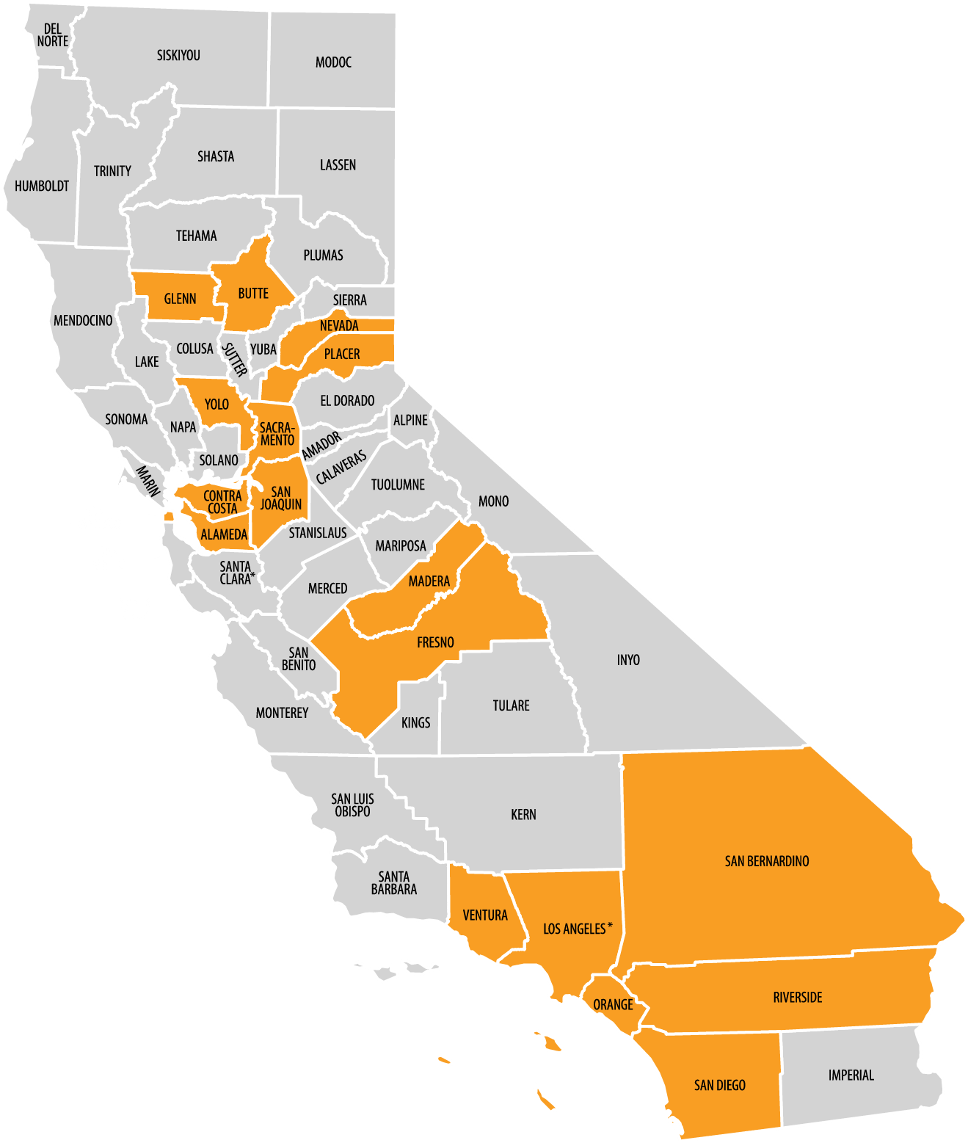
background
project
Collaboration between (13) 211 Call Centers and Kick It California, a statewide tobacco cessation program that is operated through the University of California San Diego.
County | 211 Call Center
Alameda | Eden I&R
Bay Area | UW Bay Area
Butte, Glenn | Help Central
Contra Costa | Contra Costa
Fresno, Madera | UW Fresno/Madera
Los Angeles | Los Angeles
Nevada, Placer | Connecting Point
Orange County | People for Irvine Community Health DBA 2-1-1 Orange County
Riverside, San Bernardino | UW Inland Empire
Sacramento, Yolo | Community Link Capital Region
San Diego | INFO LINE of San Diego County
San Joaquin | San Joaquin
Ventura | Interface
Funded by California Tobacco Control Program (CTCP) ▪ California Department of Public Health (CDPH)

Slide 4

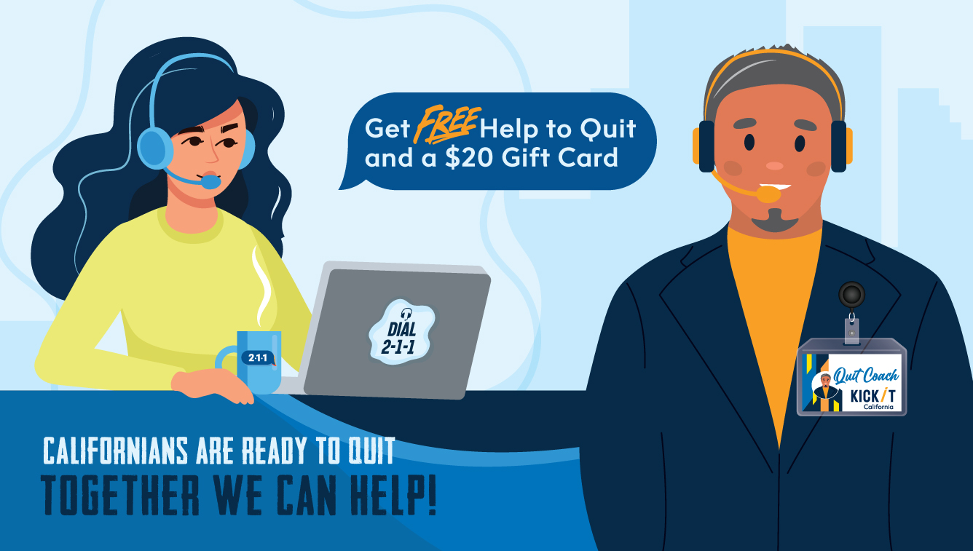
purpose
project
The project’s primary purpose is to help Californians quit smoking, vaping, and using smokeless tobacco.
211 & Kick It California are ideal partners to reach low-income and minority communities that have higher rates of smoking & vaping.

Slide 5
overview
project
211 SCREENS CALLERS FOR
Program Eligibility
Interest
Consent to Refer to KIC
211 SENDS CALLER INFO TO KIC
Name
Phone Number
Email (optional)
KICK IT CALIFORNIA CALLS TO
Enroll person
Complete counseling
Send $20 gift card
There are two incentives to help with this:
The caller will receive a $20 gift card if they agree to be referred, enroll in the Kick It California program, and complete one counseling call.
The 211 call center will receive $20 for every referred caller.

Slide 6
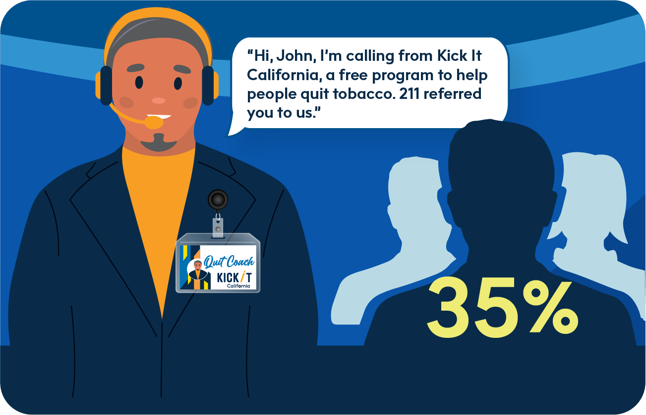
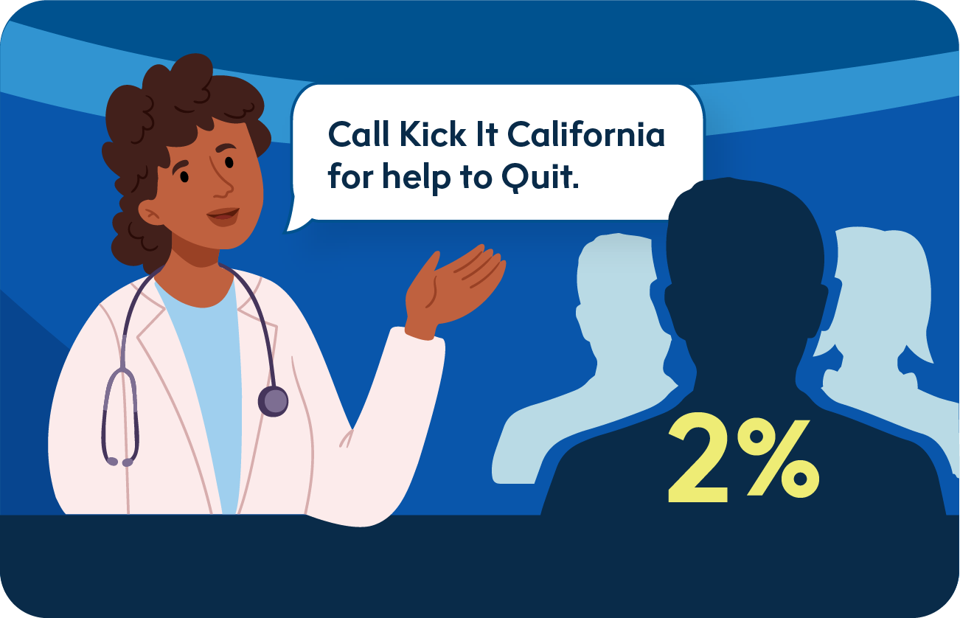
referral
proactive
Proactive Referral Yields Better Outcomes
VS

Slide 7
referral
proactive
More referrals = More People Getting Service
More people getting service = Increased Quitting
Increased Quitting = Healthier Population

Slide 8
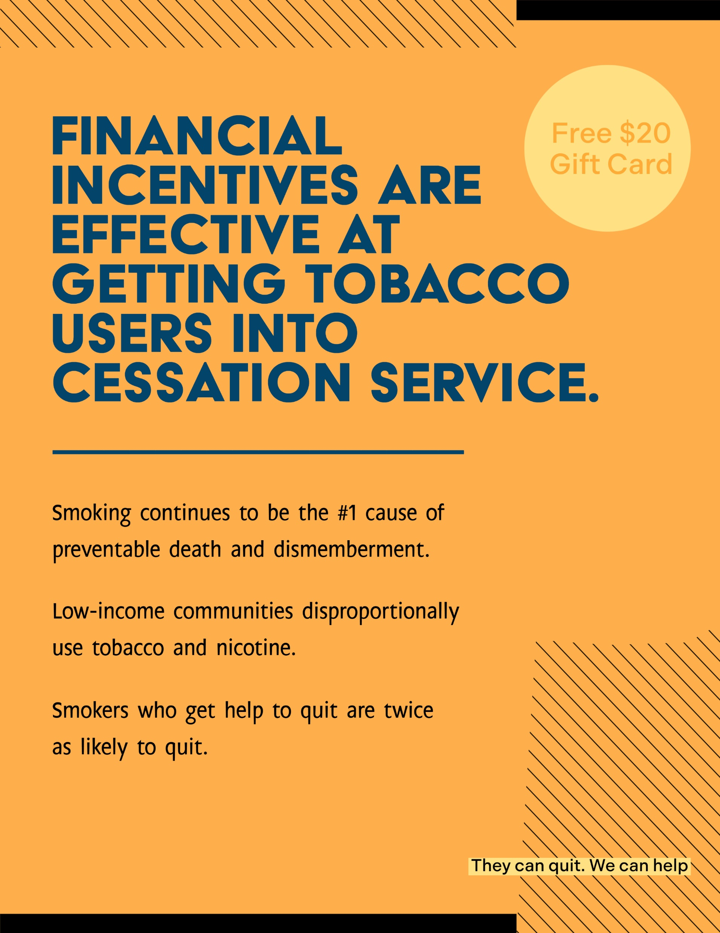


Callers
incentivizing

Slide 9


Callers
screening
OVER 18
Eligible for referral program.
UNDER 18
Call Kick It California directly or visit our website.
English: 800-300-8086 Spanish: 800-600-8191
Website: kickitca.org

Slide 10

Callers
screening
Do you smoke cigarettes, vape nicotine or use other tobacco?
Yes
Do you live with anyone who uses tobacco or vapes nicotine?
Yes
No
No

Slide 11
interest
Gauging
If the caller said they use tobacco, ask…
We partner with The University of California, San Diego – Kick It California. They have free services for smokers/vapers that can be very helpful. If you enroll and complete a telephone counseling call with them, you will receive a $20 gift card. Are you interested in quitting?
Yes
We partner with The University of California, San Diego – Kick It California. They have free services for friends and family that can be very helpful. If you enroll and complete a telephone counseling call with them, you will receive a $20 gift card. Are you interested in finding out how you can help?
Yes
No
No
If the caller said they live with someone who uses tobacco, ask…

Slide 12

Change
Stages of
Maintenance Staying tobacco-free
Action
Cutting back or quitting altogether
Preparation
Making plans to quit
Contemplation
Thinking about quitting
Precontemplation
Not at all thinking about quitting

Slide 13

Promotion
Program
Give unsure/uninterested callers more information on the program.
Reassure them that it’s worth trying.
They’ll get a free $20 gift card for their time.

Slide 14
Promotion
Program
On your schedule
Over-the-phone
Proven to double your chances of successfully quitting
Program Benefits to Convey to Clients
Free & Brief
(20-30 minutes)
Get a free $20 gift card

Slide 15

COUNSELING
KIC
Counseling is specific to the person.
We’ll talk with the person about their readiness & motivation to quit.
We’ll help them build a quit plan and talk to them about quit aids.
We’ll help them set a realistic quit date.

Slide 16
CONTACT INFO
Getting Consent &
Is it ok if I send your name and number to Kick It CA, so they can call you?
Yes
May I have your name?
First Name
No
Last Name
What is the best telephone number to reach you?
Phone Number
What is your email address?
Email

Slide 17
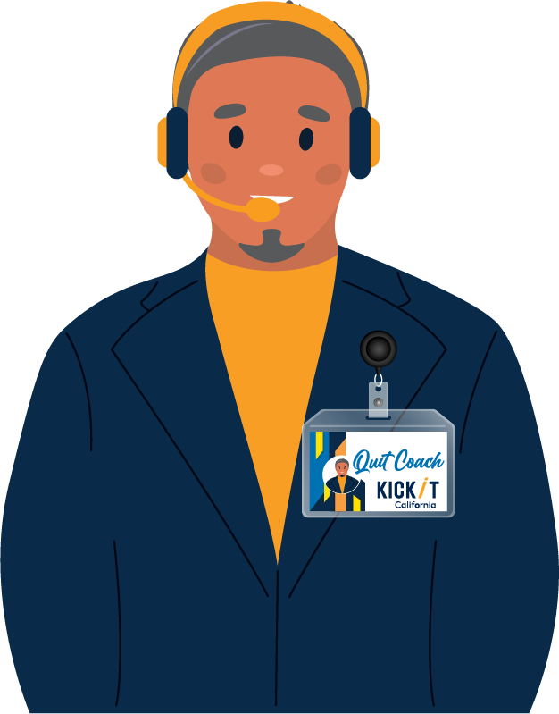


Clients
Referring
Referral Timeline
Referrals are added to Kick It California’s call list the day after we receive their information from 211.
We will make five call attempts over two weeks to reach the referred person.
If the person is not reached after five calls, we stop calling.

Slide 18

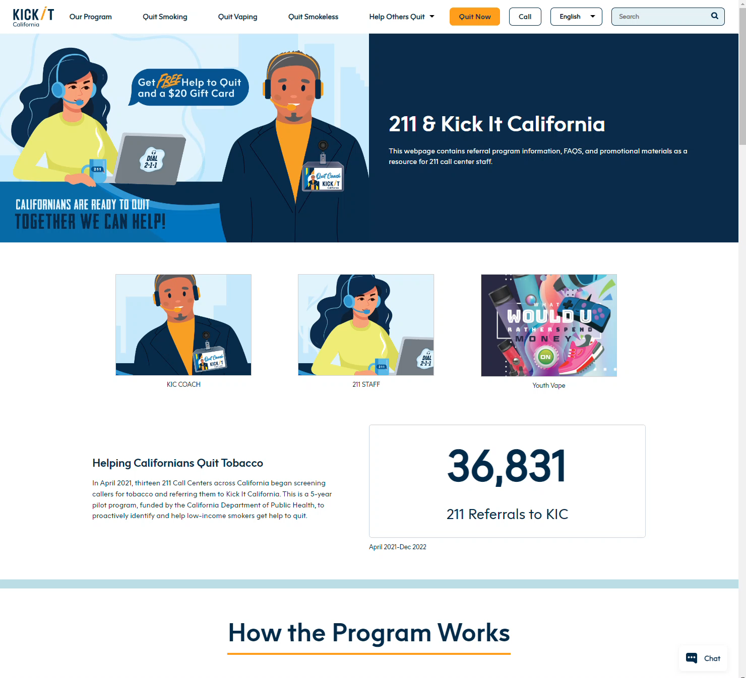

Resources
Additional
Contact Deena Wang with any questions ddw003@ucsd.heath.edu

Slide 19




Thank You
A big

