Slide 1

Ideas for the Future Discussion
Tonia Hagaman
California Tobacco Control Program
California Department of Public Health
Notes:
First, I want to say thank you – thank you for coming to meet with us and one another for the past two days, thank you for sharing your thoughts, ideas, opinions, and suggestions to help us shape this project as we move into the future. And that’s what this final session is about – the future. What the rest of this funding period looks like, and what the potential is for future funding opportunities.

Slide 2
Why is Cessation important??
Smoking is responsible for:
  about 90 percent of lung cancer
  80 percent of chronic pulmonary disease deaths, and
  33 percent of deaths due to coronary heart disease and stroke.
In California, tobacco-related disease contributes to approximately 40,000 or 16 percent of adult deaths annually.
Direct health care costs attributed to tobacco use in California are $13.29 billion annually and Medicaid-related health care costs are $3.6 billion.
Notes:
To start, just a basic review to ground us. Review importance of cessation, still a key focus area to help people already addicted.
So why is cessation important?
In California, fewer adults are smoking cigarettes than ever before; however, California also has the largest number of adults who smoke – 2.8 million, which is more than the population of 23 other states.
Each year, smoking is responsible for about 90 percent of lung cancer deaths, 80 percent of chronic pulmonary disease deaths, and 33 percent of deaths due to coronary heart disease and stroke. In California, tobacco-related disease contributes to approximately 40,000 or 16 percent adult deaths annually.
Direct health care costs attributed to tobacco use in California are $13.29 billion annually, and of this California taxpayers spend $3.58 billion dollars each year to treat smoking-related disease through Medicaid.
Eliminating tobacco use would profoundly improve the health of Californians and considerably reduce health care expenditures.

Slide 3

211 Call Centers Project Review
Purpose of funding: To build a linkage between KIC and 211 service providers
Target Population: Adults that smoke and/or vape nicotine or live with someone that does.
13 Call Centers Funded
Notes:
We wanted to reach a population we had been pretty unsuccessful at reaching in the past. Low-income tobacco users are disproportionately affected with disease and death due to their tobacco use. We funded more than the anticipated number of grantees, because we wanted to see what lessons we could learn from all of you.
______________________________________________________________
For those of you who are not familiar, 211 is the crisis call center and people may call for many reasons such as needing help to find food, housing, mental health, and now for tobacco cessation help. By partnering the 211 Call centers with KIC, we were able reaching a population we haven’t reached before to support the quitline.
The purpose of the 211 project overall was to reduce the disparity between high and low-income groups by enrolling low-income tobacco users who call 211 into cessation services.
These services target adults 18 years of age and older that smoke and/or vape nicotine or live with someone that does. After releasing the RFA and reviewing the applications, 13 call centers were funded.

Slide 4

Why 2-1-1?
  Serve low income population disproportionately impacted by tobacco
  Can play an important “conduit” role in improving the health of thousands of people
  Work with a population who is calling for help
  Responded to 2.8M inquiries in California (2016 data)
Notes:
Significant portion of 211 callers are Medi-Cal beneficiaries – high tobacco use prevalence.

Slide 5
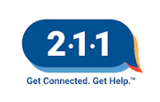
Is the model working?
Reaching the last group of smokers
Establishing an evidence base
Producing evidence to support government investment
80% of clients covered by Medicaid and have cessation benefits they could use
Model for other states
Notes:
In a word – YES!

Slide 6
What Might the Future Hold?

Slide 7
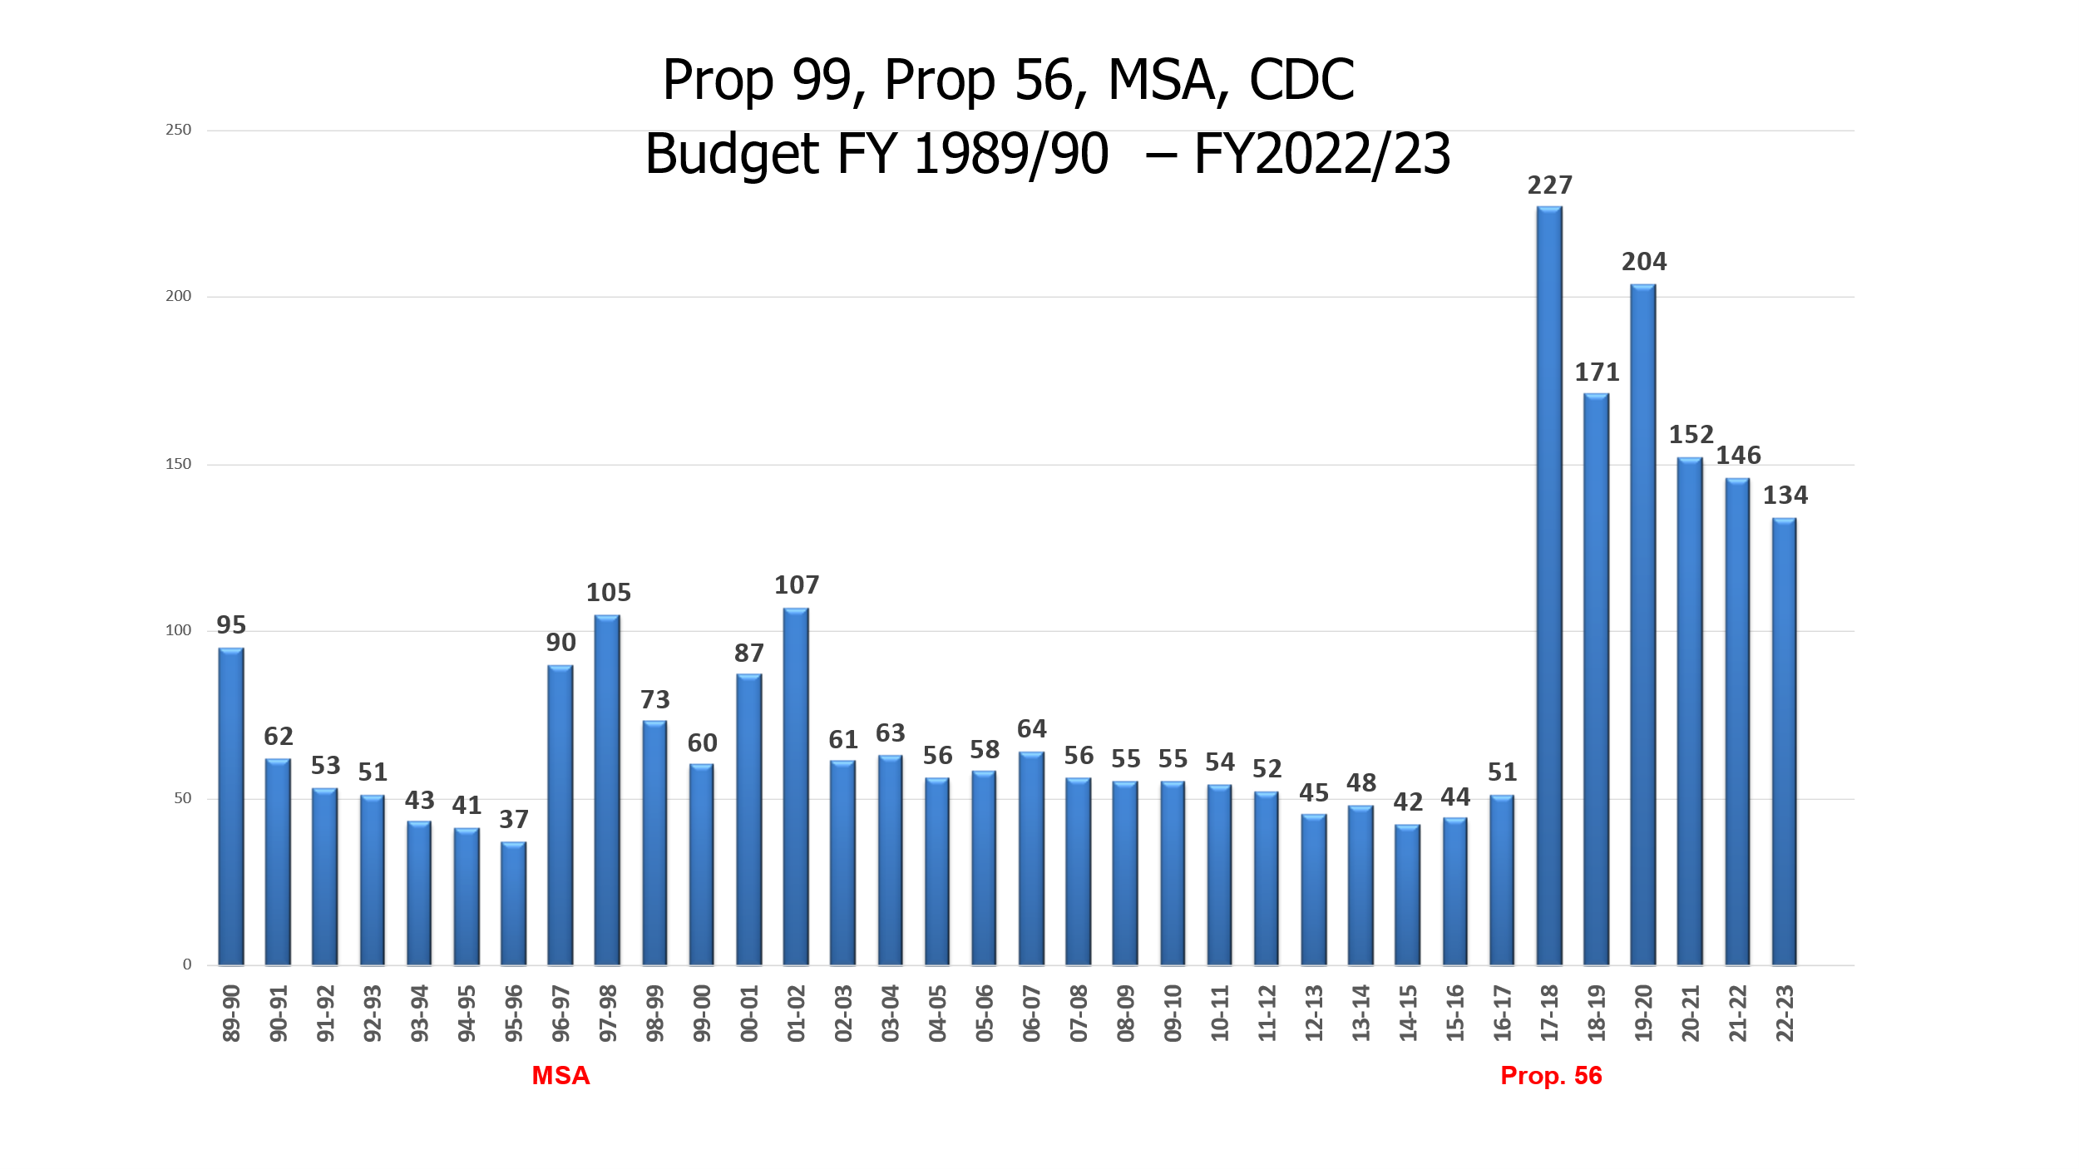
Notes:
Tobacco Control in CA has been very fortunate – we are one of the best funded public health programs in the world. And we’re very good at what we do, which, based on our own funding model, creates some problems. Our funding is based on state tobacco taxes – and as we work to decrease accessibility, acceptability and use of tobacco, our budget decreases. Which is fine, up to a point. But when you are dealing with the evil masterminds of the tobacco industry with virtually unlimited budgets, things can get tight. So the reality is, our funding will continue to drop, and in order to do more with less, we will need to refine our strategies, look for new partners, and continue to do more with less.
And that is where I want to take this discussion next – break into three groups, gather round, each group takes one question, rotate groups.

Slide 8
Sustainability
Could the project be done with less funding?
What are key elements supported with CTCP funds?
Are there other funding sources or models that could support part of this work?
Notes:
211s largely supported by government funding – are there intersections we should consider?
Other organizations to approach/partner with?

Slide 9
What Would Make Things Easier?
Notes:
Large Group Exercise – Flip Charts
And/or less costly?
Next, let’s talk about the current projects. This is a pilot project – so to begin with, we weren’t sure what would be needed or helpful, and we wanted to be sure we were covering everything. At this point, these projects are moving along pretty smoothly, so it seems like a good point to check in and find out what could be streamlined without sacrificing the key information we need to be able to scale things up when there is an opportunity.

Slide 10

roles of partners
CDPH: Funder; provide oversight; monitor and evaluate project
2-1-1: Participate in training from Kick It California; adjust protocol to ask tobacco cessation questions; refer eligible callers; track and report referrals
Kick It California: Provide technical assistance and training to 2-1-1 call centers; provide counseling services to clients; track referrals and counseling sessions; manage the flow of incentives to clients; track quit success of participants; report findings
Notes:
Are there other elements or roles that are needed? Any missing pieces you wish you had or need more support for?

Slide 11
SOW and progress Reporting
Notes:
We have some ideas about the SOW, but we also want to hear from you – you have monthly numbers reports due to CTCP, which helps us track the numbers of referrals and the number of incentives provided, and there is a more in-depth progress report every 6 months to give us an idea of how you promote the project, any challenges, successes, etc. Does this seem like too much? Is there anything you feel is extraneous or that could be combined or streamlined to make reporting easier?

Slide 12
Promotion of Service
Notes:
This was an area where we had some initial challenges. How do you feel about it now? Do you create your own social media or use TECC’s? Have you written or placed newsletter articles about the service? Do you promote it on your website?
What else could you use to help you promote the service?

Slide 13
Training and Support
Notes:
CTCP - Training on application, progress reporting, use of social media
KIC – Training on connecting, protocol, refreshers
Did you feel supported? Was there too much training? Not enough training? Is there other information you need to help you implement the project better?

