Slide 1


2-1-1 Call Center Tobacco Cessation Referral Project
Carrie Kirby, M.S.
California Smokers’ Helpline
University of California, San Diego
Notes:
Hello! My name is Carrie Kirby. I’m a project manager at Kick It CA. Today I’m here to talk to you about the 211 Call Center Tobacco Cessation Referral Project. Thank you for joining me.

Slide 2


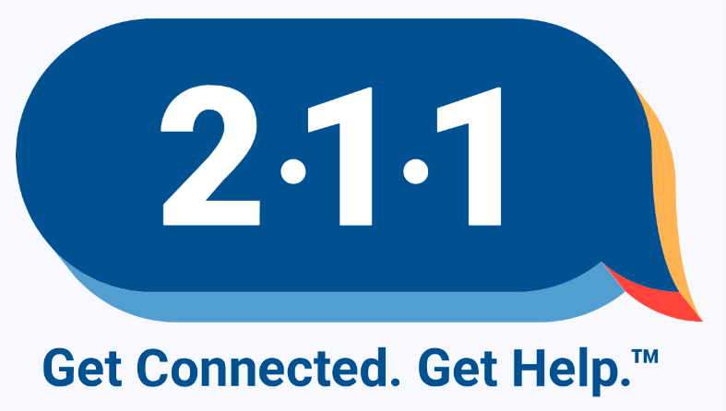

Collaboration
Notes:
This project is a collaboration between 3 entities – Kick It CA who operates as the tobacco cessation services provider. 211 Call centers – who are our referral source and California department of publich health (CDPH) specifically CTCP (California tobacco control program) who provides the funding for this project. It truly takes a village.

Slide 3
Agenda
Overall purpose and goal of project
Screening questions
Data
Q&A
Notes:
Here’s a quick snapshot of our agenda today ….

Slide 4
Our Purpose
Provide service to as many Californians as possible
Decrease tobacco use
Notes:
The overall purpose is to provide service to as many Californian’s as possible and to decrease tobacco use.

Slide 5
Project Goals
Proactively identify and refer eligible callers
Increase awareness and use of the Helpline among low-income individuals, who disproportionately experience high rates of tobacco use
Accelerate quitting behaviors and significantly reduce tobacco use
Notes:
Here are three project goals:
First, proactively identify and refer eligible callers. One of the main reasons we want to proactively identify and refer callers is that we know (as I mentioned in my earlier training) that if you (or a provider, anyone for that matter) gives a smoker/vaper our phone number, we know that only about 2-3% will call them. A whole host of reasons they won’t (no longer motivated, screaming kids at home, lost number, etc.) but if we get a proactive referral we can get about 30-40% into service.
Second, we want to increase the awareness and use of the Helpline among low-income individuals, who disproportionately experience high rates of tobacco use. We know it’s difficult to increase the awareness of our program. We’ve been around for almost 30 years, but I’m still amazed at how many people have never heard of us or if they’ve heard of us they don’t know what we do. Mass media can cost hundreds to thousands of dollars to get ONE person into cessation treatment. Back in 2013 we had a project working specifically with people who had Medi-Cal for their insurance. They have a quarterly mailing that goes out to their members, called JvR,. We started inserting a flyer into that mailer and found that to be an effective method at a cost of about $100/person. This is because it goes to low income groups who as we know have higher rates of tobaccos use, so it is more efficient. This project, the 211 Call Center project, has the potential to be as or even more efficient!
Finally, we want to accelerate quitting, some of which comes directly from the people we get into service. But it also comes from the “buzz”, “the talk around town”. When providers, community partners, etc. know about specific programs, especially evidence-based ones, they are more likely to bring up the issue of quitting within the population. So, we can accelerate quitting behaviors and reduce tobacco use by getting more people into service but even those who don’t make it to the Helpline can still be helped!

Slide 6
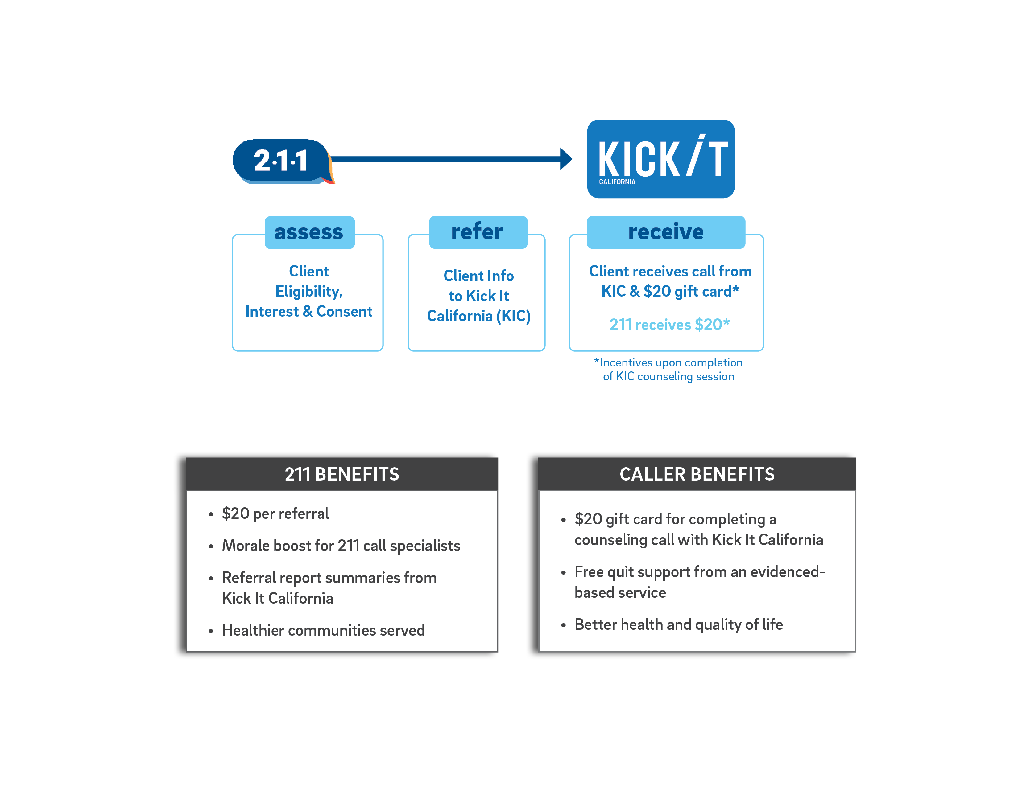
Project at a Glance
Notes:
Here is n overview of the project. At its most basic it consists of:
ASSESS: 211 asks assessment/eligibility questions broadly—most callers would only be asked two questions—(1) do you smoke, vape, or use other tobacco? (2) do you live with anyone who uses tobacco.
REFER: Refers the narrow pool who qualify
includes adults who smoke/vape nicotine/chew tobacco or adults who live with someone who does
Wants help, agrees to be referred, and gives contact information
RECEIVE: 211 callers who enroll in KIC and and complete a first counseling session receive a $20 gift card.
The final part is to promote the program—KIC will work with LLAs in the right counties to see if they can help promote and 211s may also have promotional opportunities to get the word out.

Slide 7
Assess as many as possible
Win/win/win
Tobacco users want to quit but are ambivalent
Low-income populations are heavy smokers
Low-income could use the money
Notes:
Ask as many people as possible—remember that this is meant to be a win-win-win situation for 211s, 211 callers, and KIC
Most tobacco users want to quit—they are just ambivalent. The incentive is meant to nudge them on a path they likely want anyway.
Low income populations are disproportionately affected by tobacco use.
They are more likely to be smokers—and it takes up a lot of their income.
They are also more likely to get smoking related disorders and have poorer healthcare [is this true?]
Low income populations could use $20 Walmart gift card—it is quite meaningful to them. Although it is extrinsic motivation, the amount paid not large enough to take away their intrinsic motivation
BTW—these are what are referred to as ATFL restricted and can’t be used to purchase alcohol, tobacco, firearms, or to play the lottery.

Slide 8
Why Assess?
More referrals = more people getting service
More people getting service = increased quitting
Increased quitting = healthier population
Notes:
Remember this is a triple win for clients, the call center and KIC. A win for 211 as they can offer an incentive to their caller, they receive funding, the Helpline as we get callers and the tobacco users get service. More people getting treatment also means fewer kids exposed to secondhand smoke and a healthier population.

Slide 9
How to Assess? Screening Questions
1.Do you smoke cigarettes, vape nicotine or use other tobacco?
Yes
No
2. Do you live with anyone who uses tobacco or vapes nicotine?
Yes
No
Notes:
This is where you, the 211 call center comes in. You will be asking some additional questions to screen callers. Let’s take a look at those questions. First, we need to assess where the person smokes cigarettes or vapes nicotine.
So, you will ask:

Slide 10
Non-Smokers
Current prevalence in CA is 10% – around 18% for Medi-Cal
We know that MANY callers will be non-smokers
We anticipated that only about 15-20% of all callers will be eligible for the program (either being a smoker/vaper or living with someone)
For those who aren't eligible, you will only be asking two questions
Notes:
I want you all to be aware that you will encounter many that don’t smoke, and that is ok. As I mentioned earlier, we know that lower SES have a higher smoking prevalence, however, that’s still about 18% in the state of CA.

Slide 11
Gauging Interest
We partner with The University of California, San Diego – Kick It California. They have free services for smokers/vapers that can be very helpful. If you enroll and complete a telephone counseling call with them, you will receive a $20 gift card. Are you interested in quitting?
Yes
No
2. We partner with The University of California, San Diego – Kick It California. They have free services for friends and family that can be very helpful. If you enroll and complete a telephone counseling call with them, you will receive a $20 gift card. Are you interested in finding out how you can help?
Yes
No
Notes:
For those who are smoking or vaping we need to gauge their interest in participating. Here are the questions you ask:

Slide 12
Stages of Change
Precontemplation:
Not at all thinking about quitting
Contemplation:
Thinking about quitting
Preparation:
Making plans to quit
Action:
Taking action to quit
Maintenance:
Quitting and remaining tobacco-free
Notes:
Realize the quitting is a process and clients go through various stages of change.

Slide 13
Not Interested
Varying places in stages of change
Hope was incentive would push people who might be on the fence
Are they hearing the message?
Mention more about the program
Free
Comfort of their own home – telephone based
Brief – 20-30 minutes
On their schedule
Proven success – double a smokers’ chance of successfully quitting
Notes:
For those who may sound ambivalent or aren’t interested, you many want to mention more about our program, what does it involve – it’s FREE, from thee comfort of their own home and a time convenient for them. It’s brief and has been proven to double their chance of successfully quitting!

Slide 14
Phone & Email Address Number
Email address NOT needed for referral
Phone IS needed for referral
In order to receive gift card – they must complete the first counseling call, which is done over the phone
Notes:
The last screening questions ask for phone and email. Email address isn’t needed to a referral, however, a phone IS needed. This is because the counseling is done over the phone and in order to receive the $20 gift card they must complete the first counseling call.

Slide 15
211 Call Center Data April 2021 – Dec 2023
Total Calls = 2,009,265
Total Screened = 760,106 (38% of Total Calls)
Meet Criteria = 93,500 (12% of Screened)
Referrals Sent = 41,642 (45% of Eligible that met criteria)
Notes:
Here is a look at some data for the project. It’s VERY promising! You can see that the 13 211 call centers have received over 1.5 million calls. Of those calls almost 600,000 have been screened, over 71,000 have met the criteria and over 35,000 referrals have been sent!

Slide 16

Partnership
Project
Collaborate
Teamwork
Growth
Success
Win-Win
Notes:
So, as you can hear …. This is a Partnership – we have a shared responsibility. Within this partnership is a project, collaboration, teamwork, growth, success and win-win.
Project – We’ve created this 211 project
Collaborate – Now we are collaborating – working together toward a shared goal – increasing awareness and use of KIC’s cessation services
Teamwork – Everyone has their own job – 211 operators, Directors, Managers, KIC coaches, researchers, etc. but we all have the same goal – that of increasing the use of KIC and decreasing tobacco use with help of 211
Growth – we want to grow the project over time – see referrals increase over time
Success – increase referrals to KIC which will accelerate quitting behaviors and ultimately quit rates
Win – Win – project is a win for all involved – 211 callers, KIC, 211 call centers and CDPH

Slide 17

THANK YOU
Please reach out to Deena Wang for questions!
ddw003@health.ucsd.edu

