Slide 1

Tobacco Cessation Promotion & Referrals
Carrie Kirby, Project Manager, M.S.
Notes:
Hi everyone. Thank you for taking the time to learn more about KIC and the Living Healthy Clinic Initiative referral partnership. Today, Carrie Kirby, KIC’s project manager, and myself are going to provide a brief overview about KIC’s free tobacco cessation services and on how to refer your patients to KIC.

Slide 2

About Kick It California
Notes:
ANNA

Slide 3
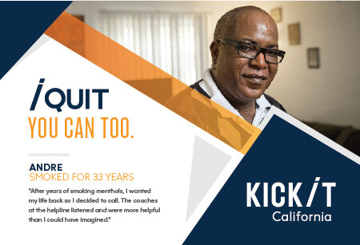
What is KIC?
FREE statewide cessation program
Started in 1992 by UCSD researchers. Since then, we have helped nearly a million Californians
Funded by tobacco taxes Props 99, 10 & 56
Validated in randomized controlled trials
Available to ALL California residents
Open Mon-Fri (7am-9pm); Sat (9am-5pm)
Multiple languages: English, Spanish, Mandarin, Cantonese, Korean, Vietnamese
Notes:
Let’s start with introducing KIC. What is KIC? KIC, previously known as the California Smokers’ Helpline or 1-800 NO BUTTS, is a FREE statewide tobacco cessation program operated by UC San Diego funded by CTCP and First 5 California. Our program, which has been validated in several randomized control trials, is available to ALL California residents and provides quit coaching services in English, Spanish, Mandarin, Cantonese, Korean, and Vietnamese. In our 30 years of history, we've helped 1 million people quit through free, customized, one-on-one coaching that is grounded in science.

Slide 4

History
Notes:
This 2022 KIC turned 30 and here’s a brief video about KIC’s history which highlights the program’s milestones.

Slide 5
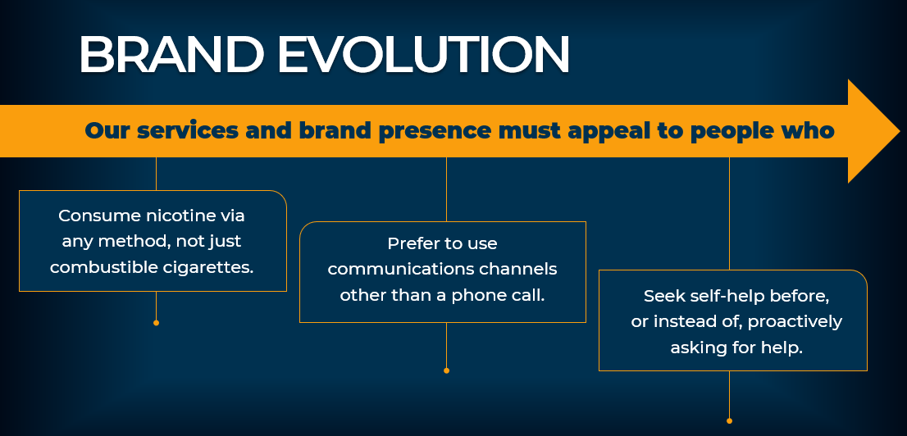


Brand Evolution
In 2020, the California Smokers’ Helpline, in consultation with our funder, CTCP, completed a 3-month discovery period led by a creative agency.
We conducted focus groups and surveys of people who smoke and vape, as well as our quit coaches; and we met with our funders and advocates across the tobacco control community to inform this evolution.
Notes:
Now let’s talk rebrand. Most of you might not be familiar with the brand KIC, however, you might recognize the name 1800 NO BUTTS or the California Smokers Helpline.
In 2020, the California Smokers’ Helpline, in consultation with our funder, CTCP, completed a 3-month discovery period led by a creative agency.
We conducted focus groups and surveys of people who smoke and vape, as well as our quit coaches; and we met with our funders and advocates across the tobacco control community to inform this evolution.
For a little over a year, since September 2021, the Helpline has been operating as Kick It California:
New phone numbers
New properties
Rebranded social media pages
New & rebranded Print & digital materials
New website kickitca.org in Eng & Spa

Slide 6
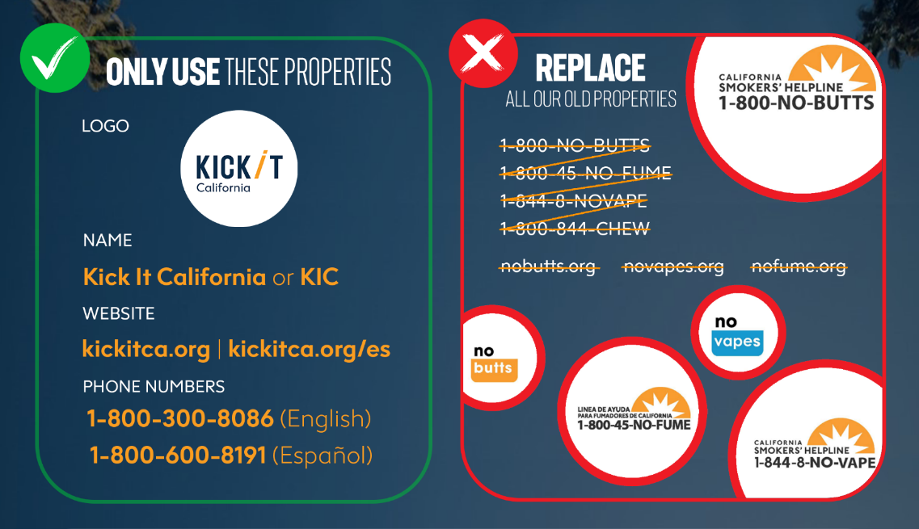
Notes:
This graphic helps with displaying a better visual representation of what our brand was and is. On our righthand side you can see the variety of old properties, and on the left, you can see the new streamlined brand experience with just one name, one website in English and Spanish and 2 phone numbers.

Slide 7
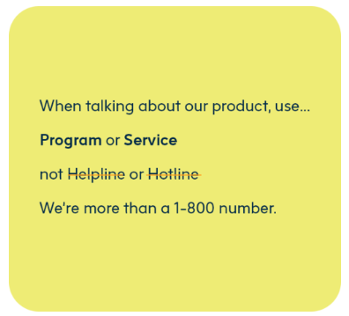
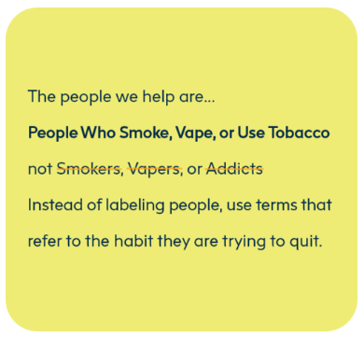
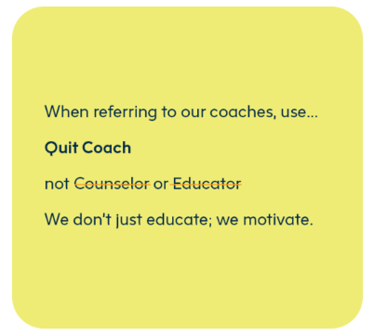
Rebrand
To build a strong brand, we needed to be consistent in the way we talk about our service. In general, we refer to Kick It California as a "text and talk-based support program" that uses "one-on-one coaching" and "proven, science-based methods" to "help people who smoke, vape, and use smokeless tobacco quit.”
Notes:
Lastly, I just wanted to talk about the new communications approach or brand story. To build a strong brand, we needed to be consistent in the way we talk about our service. In general, we refer to Kick It California as a "text and talk-based support program" that uses "one-on-one coaching" and "proven, science-based methods" to "help people who smoke, vape, and use smokeless tobacco quit.”
After providing this brief background about the KIC brand, I’m going to hand it over to Carrie, who will go over KIC’s services and resources.

Slide 8
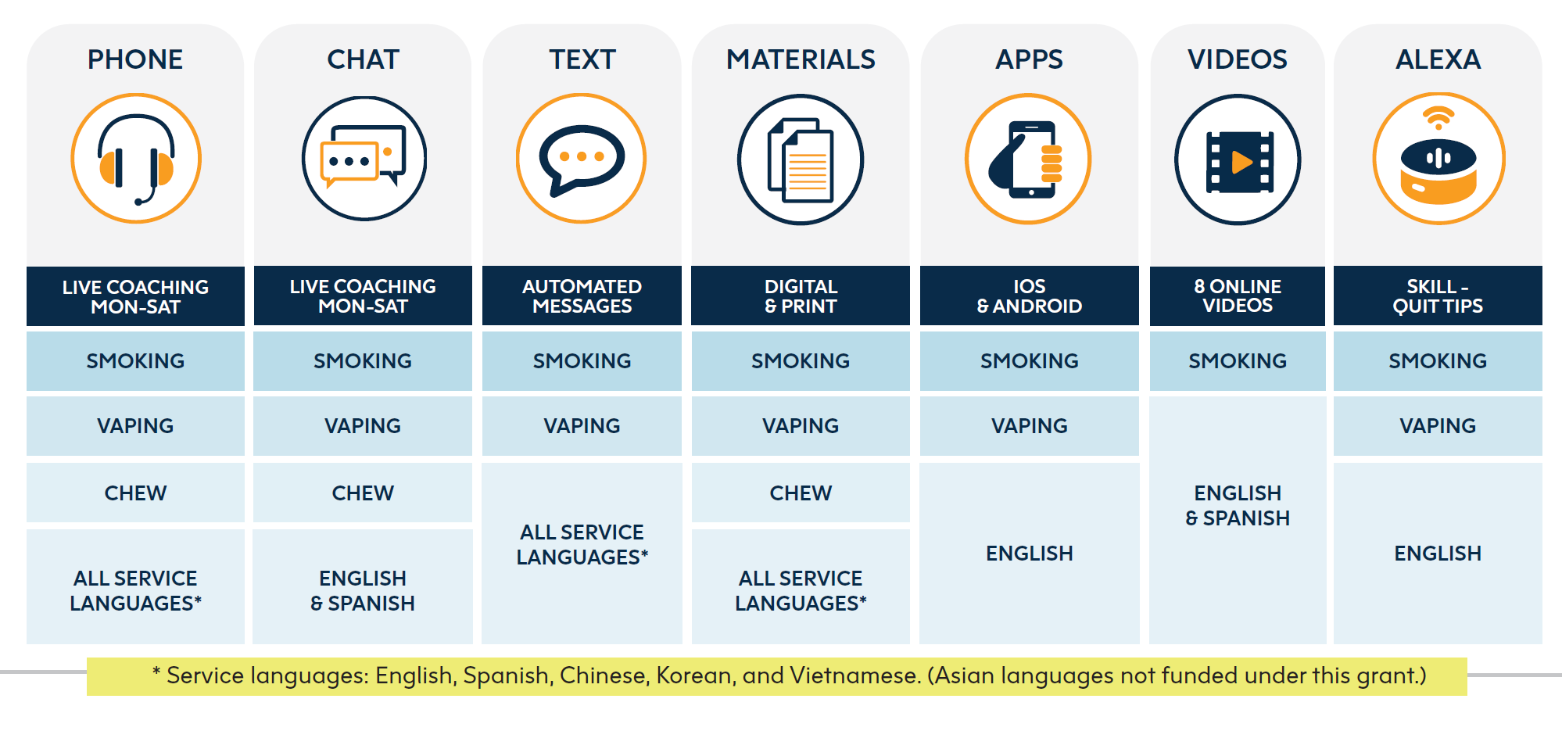
Services & resources overview
Nicotine Patches Availability
First 5 CA funds – 2-week starter kit of patches
Persons living with children 0-5, Pregnant smokers (with MD approval)
Medi-Cal
Most beneficiaries can get pharmacotherapy covered
MD prescription needed

Slide 9
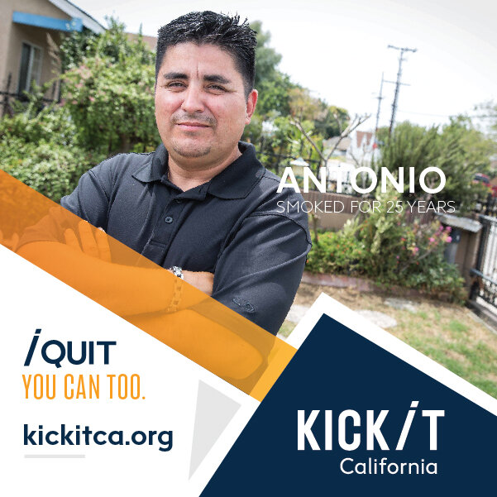
Who Do We Serve?
Adults (multiple languages, Medi-Cal, range of income, rural & urban, behavioral health, etc.)
Chew/spit tobacco users
Pregnant/nursing women
Teens
Non-tobacco using callers (proxy)

Slide 10
Quit coaching protocol
Intake call
Determine needs, ~6 min. call
First counseling session
Comprehensive, ~30 min. call
Prepare to quit
Set a quit date
Follow-up sessions
Up to four ~10 minute calls
Support and accountability
Relapse prevention
Initial Session
Motivation
Self-efficacy
Smoking & quitting history
Environmental considerations
Treatment overview & rationale
Health considerations
Quitting methods
Self-image
Planning
Call summary
Setting a quit day
Addressing follow-up calls

Slide 11
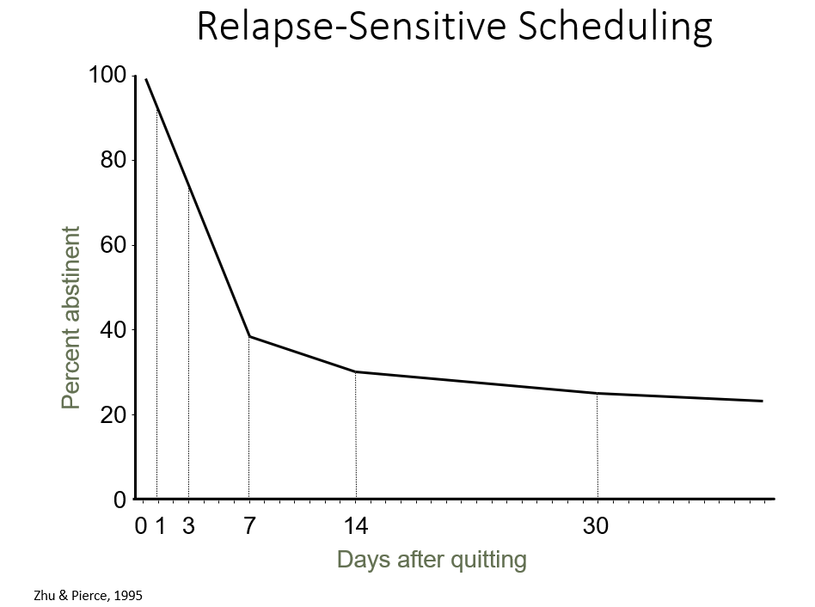
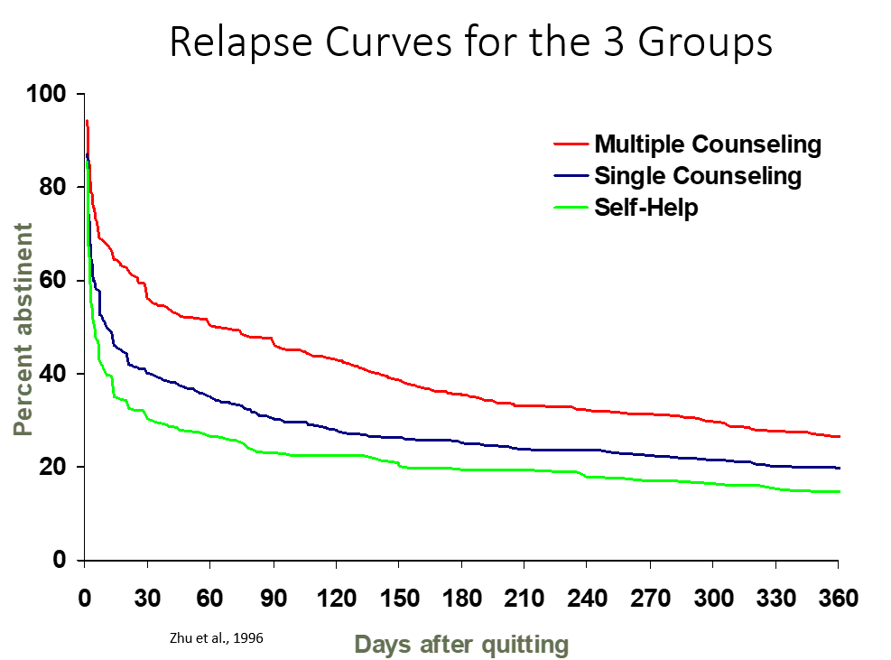
Proactive Follow-Up Sessions
Motivation & self-efficacy
Quit status
Withdrawal review
Pharmacotherapy review
Challenges & smoking events
Support
Planning for future
Self-image

Slide 12
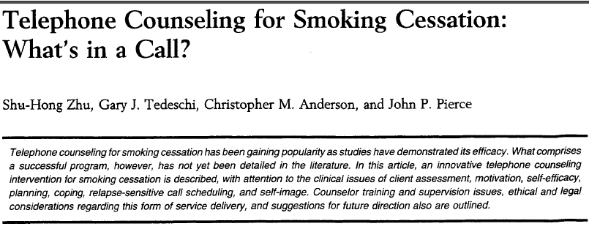
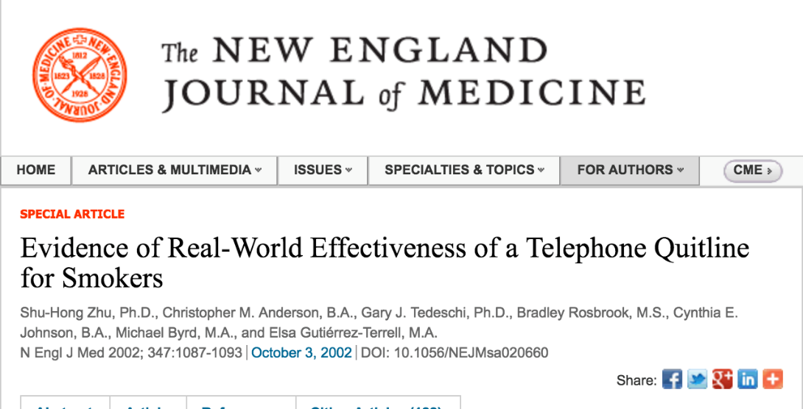
Summary of California Evidence
RCT showed:
Telephone counseling can increase quit attempts and prevent relapse
Single session can be efficacious; multiple sessions even more so

Slide 13

The Importance of Proactive Referrals From Providers

Slide 14



Using Ask-Advise-Refer (AAR)
Ask (At every visit, in a caring manner, ask each patient if they smoke/vape)
Do you (or anyone you live with) smoke?
How interested are you in quitting?
Advise (without lecturing)
Quitting is one of the best things you can do for your yourself
What do you know about how smoking affects health?
I have some information, if you’d like to hear?
Refer (connect/offer options)
Refer tobacco users (or those who live with tobacco users) to KIC to get a free, one-on-one coaching, and a personal quit plan (or a plan to help someone quit) from our trained Quit Coaches
Notes:
With Ask – important that these are open ended
Advise – we still want to provide information but want the information to be tailored to the client’s own goals. We can also ask permission to share information with the client – this communicates respect for the client. Advise patients who smoke/vape to consider quitting
Smoking can lead to or exacerbate health problems such as:
Heart and lung disease
Diabetes
Stroke
Ongoing infections and colds
Cancer
Refer – this is about connecting the client to options in line with their goals - For those who clearly don’t want to quit, don’t insist—the outcome you want is to have a friendly conversation so that they will trust you in the future. Always reiterate that you will continue to inquire about their interest in quitting in future visits and that they may reach out to you when they feel ready. quitting.
Refer (Connect)
If the patient is interested in quitting, congratulate them on their decision. Refer patients willing to quit smoking to:
Kick It California
(formerly known as California Smoker’s Helpline)
1-800-600-8191 • kickitca.org
For those who are not ready to quit or thinking about quitting, they may be ready next time. It is important to avoid being judgmental or trying to pressure the patient into quitting. Offer literature and supportive materials that emphasize the benefits of
BLACK COMMUNITY: Take in account occasional smokers. Assess level of addiction? how quickly upon awakening tobacco is used rather than the number of cigarettes smoked per day. importance of maintaining a high level of motivation throughout a quit attempt. Menthol or not menthol cigarettes. Intentions to quit with their extended family. Identify if spiritual or religious beliefs are a source of support for clients. ◾ Review that spiritual counseling through church may be beneficial during a quit attempt.
Tip #1: Utilize motivational interviewing to assist participants build commitment and reach a decision to change. • Ask permission to talk about their smoking habits. • Ask open-ended questions like, “How do you feel about quitting smoking?” • Help them understand their reasons for quitting. • Be encouraging and empathetic. Stay away from judgement comments.
If ready/not ready to quit
NRT: Decades of research have shown that the most effective way to quit smoking uses a combination of counseling and medications, such as nicotine patches, gum, and lozenges.
As their health care provider or community advisor, communicating with your Latinx patients about their tobacco use and advising them to quit might be one of the most important things you can do for your patient. Smoking is the leading cause of preventable death and ensuring that the patient knows about available help is a first step toward recovery.
According to experts/research
Prevention through education and Promotional efforts to communicate that there are free cessation services. Developing personalized campaign messaging that connects with this audience.

Slide 15





Reasons for e-Referral
Associated with a significantly higher participation rate than simple advice to quit (2-3% vs 40%)
Promotes the use of electronic health records (EHR) to improve healthcare delivery; can help organizations meet various metrics (MU, PRIME, etc.)
Clinical teams can make a big impact on the lives of their patients and reduce health care costs by referring them evidence-based tobacco treatment (i.e. KIC)
Notes:
E-referral to the Helpline is a very effective method for increasing tobacco interventions and these type of referrals have become so popular over the last few years because of technology and their various benefits. Of which I want to focus on the top three.
Some people are uncomfortable initiating contact with the Quit Line, others forget or lose the phone number
Simple advice to quit results in about 2-3% reach among smokers, while online referral reaches about 40%
For Healthcare Providers:
Incorporates cessation into routine healthcare delivery
Provides opportunity for system change to improve effectiveness, removing time and resource barriers
Assists in meeting quality measures for tobacco cessation
Increases knowledge of latest cessation counseling and pharmacotherapy protocol
Every smoker – Every encounter: ensure that every smoker receives support at every encounter by using the EHR.
Uliymatey for Public Health Agencies and Quitlines e-referrals:
Provides cost-effective, sustainable means of reaching more tobacco users
Increases the number of calls received by quitlines
Increases the percent of callers who enroll in quitline services
The Helpline has done a couple of studies about proactive referrals. One of these was the Partnership for Smokefree Families Project (PSF). Doctors told their pregnant smokers to call us and they gave them our number. Only 2-3% called us on their own. We also got direct referrals from the clinics and proactively called, 40% of the group we called agreed to our service.
Another study was conducted in the early 90s when Los Angeles wanted to run their own cessation service. Smokers who called the Helpline and lived in LA were given the info for their county service. We then followed up and found very few actually used the LA service (about 4%).
From March 1999 to Sept 2003, providers referred 2,322 women to CSH. Of these, only 2% called. Among those who did not call the Helpline, Helpline counselors called them – making 5 attempts over different days and times to contact each woman who was referred but who had not called. Through these proactive efforts, the number of women reached rose from 2% to 67%.

Slide 16
Referring to KIC
Proactive Referrals
Electronic referrals (through health record) or web-based referral
Means Helpline calls the patient – patient doesn’t initiate the call
Workflow for Proactive Referrals:
Clinic/Hospital:
Screens patient for tobacco use
Sends referral to Helpline
KIC:
Receives patient information
Attempts patient to try and enroll in services
Notes:
Now that I briefly touched about KIC’s services I want to talk about proactive e-referrals. This means that we receive information on a patient instead of the patient reaching out to us.
KIC is being proactive versus reactive (i.e. reacting to the patients call)

Slide 17
Notes:
Now that I briefly touched about KIC’s services I want to talk about proactive e-referrals. This means that we receive information on a patient instead of the patient reaching out to us.
KIC is being proactive versus reactive (i.e. reacting to the patients call)

Slide 18
Benefits of KIC e-Referral
Documentation
Smoking Status
Reduce provider burden
Off-load work to “experts”
Patients will get the message that staff want to help them quit.
Reach
High risk populations with high tobacco rates that are often served by community clinics
Consistent with AAFP recommended tobacco practices
Can be incorporated into interventions for behavioral health patients, who have the highest rates of tobacco use
Tobacco Interventions

Slide 19
Background of e-Referral
2013
Began electronic referrals (e-Referral) in 2013 with UC Davis
2014
Expanded to 3 additional 3 UC’s in 2014 and a 4th in 2015
2015
Designated as Specialized Registry in 2015
2016
Since 2016 partnered with over 60 clinics, hospitals, etc. to implement e-Referral program

Slide 20
Referrals Over Time

Slide 21
e-Referral Methods
There are three methods for transferring the data to the Helpline:
DIRECT messaging
Traditional (Peer-to-Peer)
Custom

Slide 22

DIRECT Project
Developed by Office of National Coordinator (ONC)
Meets MU requirements
Small start up costs
Additional fee to build results messages
Easy implementation
Sign up for a Direct Account (CA Direct, or EMR Direct) through a HISP
Once approved, provider can start referring either through the EHR or by simply opening up a browser
If referral coming through EHR – integrate into workflow

Slide 23
Traditional
Order built within EHR
Similar to any other referral that a provider would do in their day-to-day workflow, like ordering an X-ray
Receive results messages from Helpline (result of an Order)
Can limit the amount of data sent and received
Meets MU
Requires IT resources
Large start up costs ($7,000+) + monthly maintenance
System admin time, engineering time, etc.
Notes:
- Aggregate reporting but also individual messages (1 of 9 messages, such as received counseling, smoking status, received materials, etc.)

Slide 24
Custom
Standard formats (e.g. CSV, pipe delimited, fixed length, etc.)
Standard transports (e.g. web-services, SOAP, etc.)

Slide 25
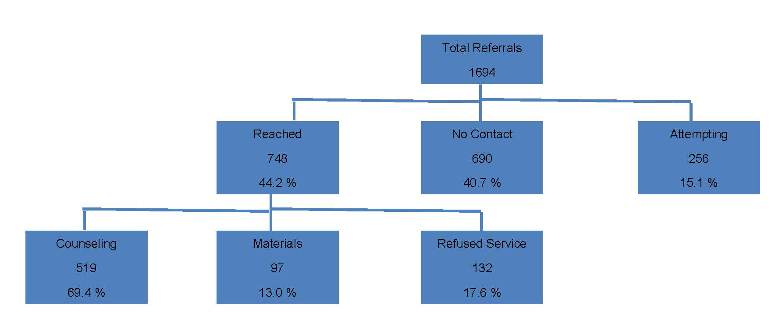
Sample Summary Referral Report

Slide 26


Promoting Kick It California
In order to raise awareness about our free, nonjudgmental, confidential services and our partnership with clinics, we recommend you promote or mention the partnership with KIC on your website, social media, and other outreach channels, if possible.
Follow us and reshare our social media posts @kickitca on Facebook, IG, Twitter, and YouTube
Educational Materials
Promotional Materials
Trainings
Join our Email List
For TA or custom training opportunities, email cshoutreach@ucsd.edu
Join our email list to not miss out on our newest cessation news & initiatives!
Notes:
Last but not least, I wanted to briefly touch on promoting KIC. In order to raise awareness about our free, nonjudgmental, confidential services and our partnership with HLCI clinics, we recommend you promote or mention the partnership with KIC on your website, social media, and other outreach channels, if possible. However, please be mindful that your promotions should stay within our partnership limits for increased referral outcomes. Which means that if you heavily promote KIC general services (and not the HLCI clinic-specific form) you run the risk on not being able to track the patients that contacted KIC directly and not trough your system. However, that percentage is normally very low. That said, feel free to find inspiration or reshare our social media posts when promoting the partnership, use and customize our educational and promotional materials, watch our available trainings for further cessation information, join our email list to not miss out on our latest news and initiatives and email us for Technical Assistance or custom training opportunities. We’re almost done with the presentation, and we will soon open it up for questions, but before that, Carrie is going to talk about how this joint initiative can become a pilot project in hopes to show proof of concept.

Slide 27

Questions?
Notes:
CARRIE

Slide 28

Thank you!
Questions? Please email
ckirby@health.ucsd.edu

