Slide 1

Tobacco Cessation
Promotion & Referrals
Carrie Kirby, Project Manager, M.S.
Notes:
Hi everyone. Thank you for taking the time to learn more about KIC and the Living Healthy Clinic Initiative referral partnership. Today, Carrie Kirby, KIC’s project manager, and myself are going to provide a brief overview about KIC’s free tobacco cessation services and on how to refer your patients to KIC.

Slide 2
Trainings Done July – Dec 2023
All trainings given during this reporting period are attached in this one PPT

Slide 3

About Kick It California
Notes:
ANNA

Slide 4
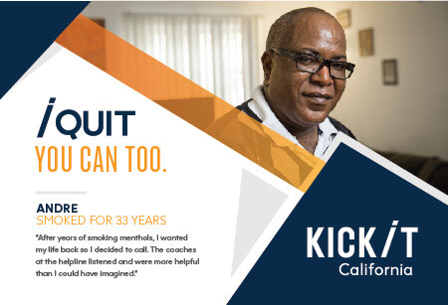
What is KIC?
FREE statewide cessation program
Started in 1992 by UCSD researchers. Since then,
we have helped nearly a million Californians
Funded by tobacco taxes Props 99, 10 & 56
Validated in randomized controlled trials
Available to ALL California residents
Open Mon-Fri (7am-9pm); Sat (9am-5pm)
Multiple languages: English, Spanish, Mandarin,
Cantonese, Korean, Vietnamese
Notes:
Let’s start with introducing KIC. What is KIC? KIC, previously known as the California Smokers’ Helpline or 1-800 NO BUTTS, is a FREE statewide tobacco cessation program operated by UC San Diego funded by CTCP and First 5 California. Our program, which has been validated in several randomized control trials, is available to ALL California residents and provides quit coaching services in English, Spanish, Mandarin, Cantonese, Korean, and Vietnamese. In our 30 years of history, we've helped 1 million people quit through free, customized, one-on-one coaching that is grounded in science.

Slide 5

History
Notes:
This 2022 KIC turned 30 and here’s a brief video about KIC’s history which highlights the program’s milestones.

Slide 6
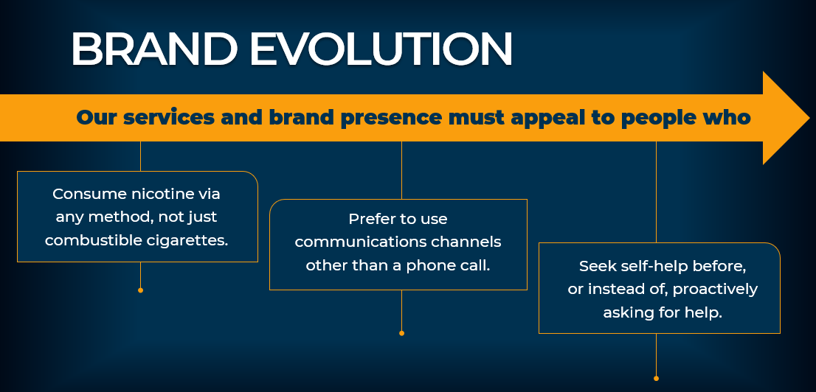


Brand Evolution
In 2020, the California Smokers’ Helpline, in consultation with our funder, CTCP, completed a 3-month discovery period led by a creative agency.
We conducted focus groups and surveys of people who smoke and vape, as well as our quit coaches; and we met with our funders and advocates across the tobacco control community to inform this evolution.
Notes:
Now let’s talk rebrand. Most of you might not be familiar with the brand KIC, however, you might recognize the name 1800 NO BUTTS or the California Smokers Helpline.
In 2020, the California Smokers’ Helpline, in consultation with our funder, CTCP, completed a 3-month discovery period led by a creative agency.
We conducted focus groups and surveys of people who smoke and vape, as well as our quit coaches; and we met with our funders and advocates across the tobacco control community to inform this evolution.
For a little over a year, since September 2021, the Helpline has been operating as Kick It California:
New phone numbers
New properties
Rebranded social media pages
New & rebranded Print & digital materials
New website kickitca.org in Eng & Spa

Slide 7
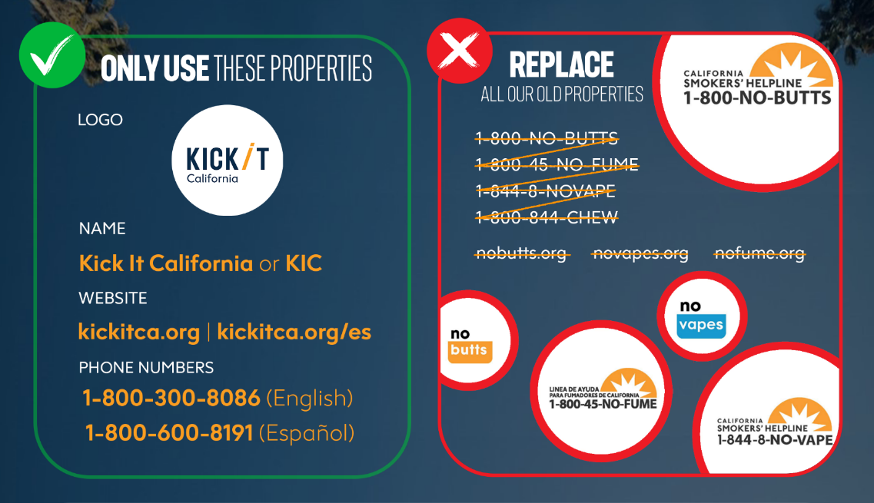
Notes:
This graphic helps with displaying a better visual representation of what our brand was and is. On our righthand side you can see the variety of old properties, and on the left, you can see the new streamlined brand experience with just one name, one website in English and Spanish and 2 phone numbers.

Slide 8
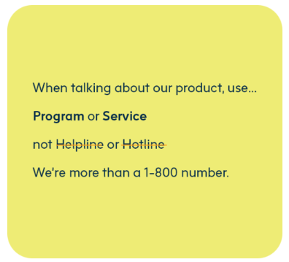
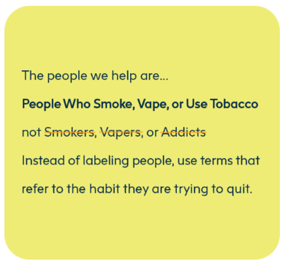
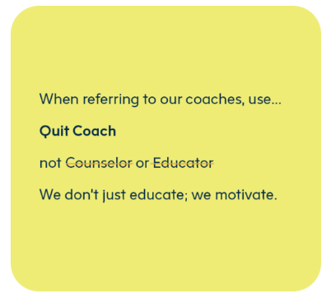
Rebrand
To build a strong brand, we needed to be consistent in the way we talk about our service. In general, we refer to Kick It California as a "text and talk-based support program" that uses "one-on-one coaching" and "proven, science-based methods" to "help people who smoke, vape, and use smokeless tobacco quit.”
Notes:
Lastly, I just wanted to talk about the new communications approach or brand story. To build a strong brand, we needed to be consistent in the way we talk about our service. In general, we refer to Kick It California as a "text and talk-based support program" that uses "one-on-one coaching" and "proven, science-based methods" to "help people who smoke, vape, and use smokeless tobacco quit.”
After providing this brief background about the KIC brand, I’m going to hand it over to Carrie, who will go over KIC’s services and resources.

Slide 9
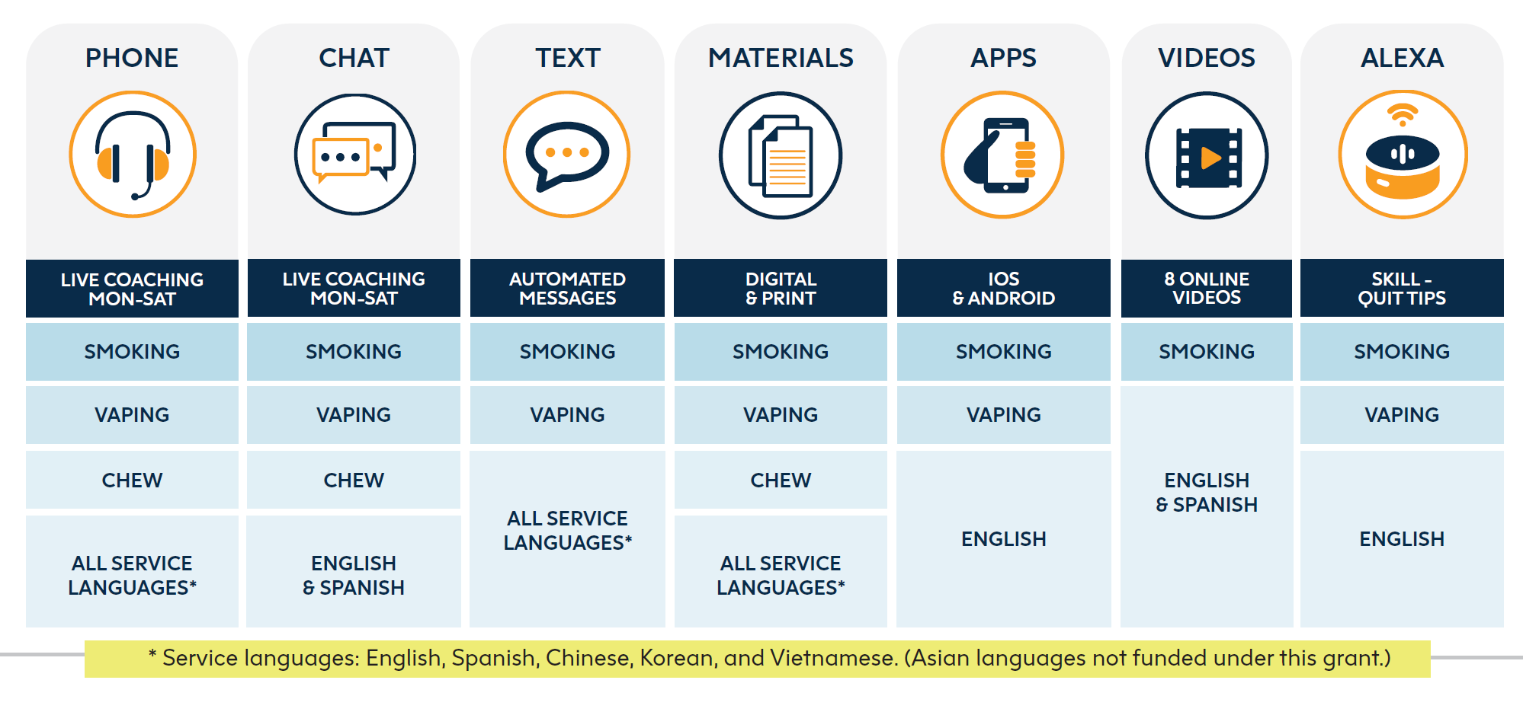
Services & resources overview
  Nicotine Patches Availability
  First 5 CA funds – 2-week starter kit of patches
    Persons living with children 0-5, Pregnant smokers (with MD approval)
  Medi-Cal
    Most beneficiaries can get pharmacotherapy covered
    MD prescription needed

Slide 10
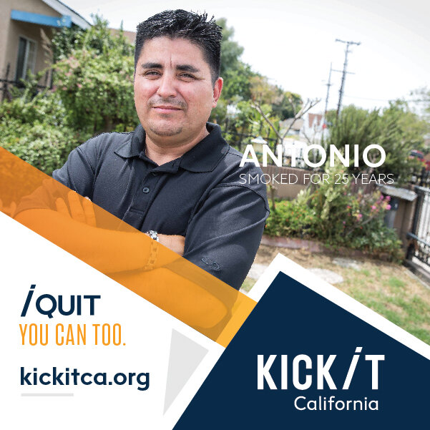
Who Do We Serve?
Adults (multiple languages, Medi-Cal, range of income, rural & urban, behavioral health, etc.)
Chew/spit tobacco users
Pregnant/nursing women
Teens
Non-tobacco using callers (proxy)

Slide 11
Quit coaching protocol
Intake call
Determine needs, ~6 min. call
First counseling session
Comprehensive, ~30 min. call
Prepare to quit
Set a quit date
Follow-up sessions
Up to four ~10 minute calls
Support and accountability
Relapse prevention
Initial Session
Motivation
Self-efficacy
Smoking & quitting history
Environmental considerations
Treatment overview & rationale
Health considerations
Quitting methods
Self-image
Planning
Call summary
Setting a quit day
Addressing follow-up calls

Slide 12
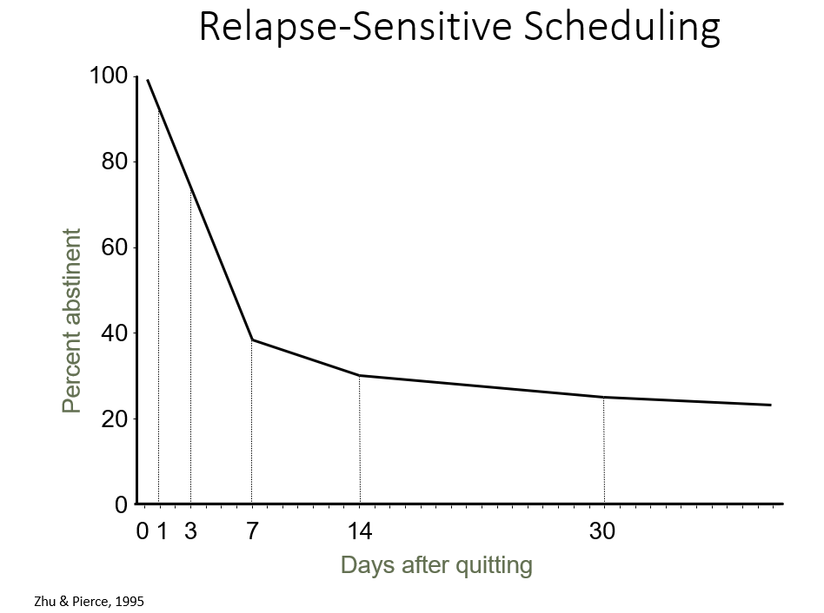
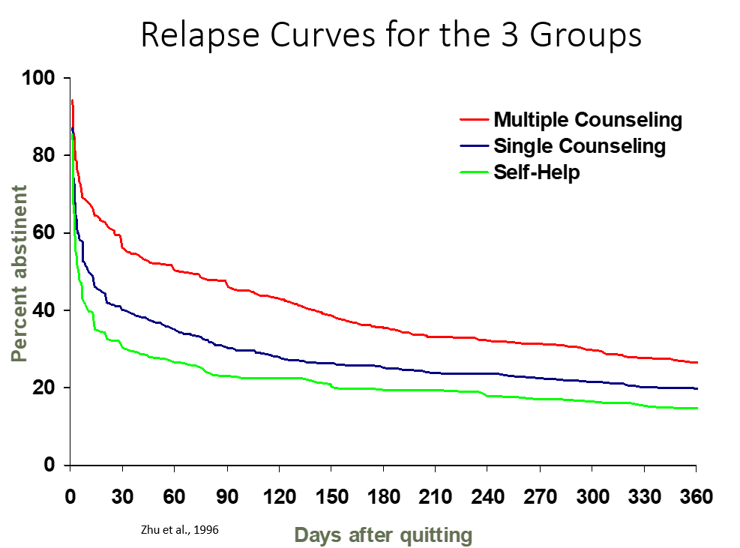
Proactive Follow-Up Sessions
Motivation & self-efficacy
Quit status
Withdrawal review
Pharmacotherapy review
Challenges & smoking events
Support
Planning for future
Self-image

Slide 13
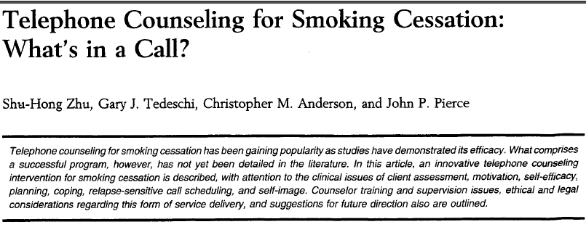
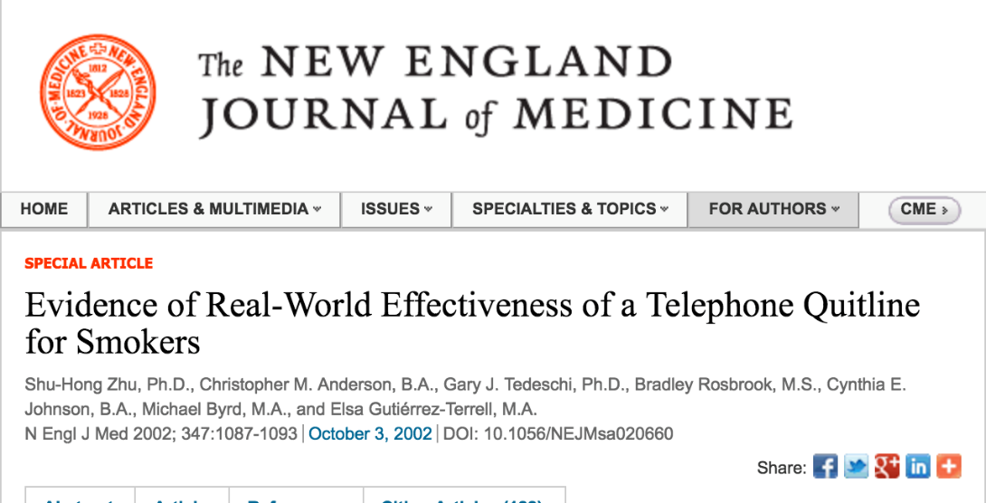
Summary of California Evidence
RCT showed:
  Telephone counseling can increase quit attempts and prevent relapse
  Single session can be efficacious; multiple sessions even more so

Slide 14

The Importance of Proactive
Referrals From Providers

Slide 15



Using Ask-Advise-Refer (AAR)
Ask (At every visit, in a caring manner, ask each patient if they smoke/vape)
  Do you (or anyone you live with) smoke?
  How interested are you in quitting?
Advise (without lecturing)
  Quitting is one of the best things you can do for your yourself
  What do you know about how smoking affects health?
  I have some information, if you’d like to hear?
Refer (connect/offer options)
  Refer tobacco users (or those who live with tobacco users) to KIC
  to get a free, one-on-one coaching, and a personal quit plan
  (or a plan to help someone quit) from our trained Quit Coaches
Notes:
With Ask – important that these are open ended
Advise – we still want to provide information but want the information to be tailored to the client’s own goals. We can also ask permission to share information with the client – this communicates respect for the client. Advise patients who smoke/vape to consider quitting
Smoking can lead to or exacerbate health problems such as:
Heart and lung disease
Diabetes
Stroke
Ongoing infections and colds
Cancer
Refer – this is about connecting the client to options in line with their goals - For those who clearly don’t want to quit, don’t insist—the outcome you want is to have a friendly conversation so that they will trust you in the future. Always reiterate that you will continue to inquire about their interest in quitting in future visits and that they may reach out to you when they feel ready. quitting.
Refer (Connect)
If the patient is interested in quitting, congratulate them on their decision. Refer patients willing to quit smoking to:
Kick It California
(formerly known as California Smoker’s Helpline)
1-800-600-8191 • kickitca.org
For those who are not ready to quit or thinking about quitting, they may be ready next time. It is important to avoid being judgmental or trying to pressure the patient into quitting. Offer literature and supportive materials that emphasize the benefits of
BLACK COMMUNITY: Take in account occasional smokers. Assess level of addiction? how quickly upon awakening tobacco is used rather than the number of cigarettes smoked per day. importance of maintaining a high level of motivation throughout a quit attempt. Menthol or not menthol cigarettes. Intentions to quit with their extended family. Identify if spiritual or religious beliefs are a source of support for clients. ◾ Review that spiritual counseling through church may be beneficial during a quit attempt.
Tip #1: Utilize motivational interviewing to assist participants build commitment and reach a decision to change. • Ask permission to talk about their smoking habits. • Ask open-ended questions like, “How do you feel about quitting smoking?” • Help them understand their reasons for quitting. • Be encouraging and empathetic. Stay away from judgement comments.
If ready/not ready to quit
NRT: Decades of research have shown that the most effective way to quit smoking uses a combination of counseling and medications, such as nicotine patches, gum, and lozenges.
As their health care provider or community advisor, communicating with your Latinx patients about their tobacco use and advising them to quit might be one of the most important things you can do for your patient. Smoking is the leading cause of preventable death and ensuring that the patient knows about available help is a first step toward recovery.
According to experts/research
Prevention through education and Promotional efforts to communicate that there are free cessation services. Developing personalized campaign messaging that connects with this audience.

Slide 16





Reasons for e-Referral
Associated with a significantly higher participation rate than simple advice to quit (2-3% vs 40%)
Promotes the use of electronic health records (EHR) to improve healthcare delivery; can help organizations meet various metrics (MU, PRIME, etc.)
Clinical teams can make a big impact on the lives of their patients and reduce health care costs by referring them evidence-based tobacco treatment (i.e. KIC)
Notes:
E-referral to the Helpline is a very effective method for increasing tobacco interventions and these type of referrals have become so popular over the last few years because of technology and their various benefits. Of which I want to focus on the top three.
Some people are uncomfortable initiating contact with the Quit Line, others forget or lose the phone number
Simple advice to quit results in about 2-3% reach among smokers, while online referral reaches about 40%
For Healthcare Providers:
Incorporates cessation into routine healthcare delivery
Provides opportunity for system change to improve effectiveness, removing time and resource barriers
Assists in meeting quality measures for tobacco cessation
Increases knowledge of latest cessation counseling and pharmacotherapy protocol
Every smoker – Every encounter: ensure that every smoker receives support at every encounter by using the EHR.
Uliymatey for Public Health Agencies and Quitlines e-referrals:
Provides cost-effective, sustainable means of reaching more tobacco users
Increases the number of calls received by quitlines
Increases the percent of callers who enroll in quitline services
The Helpline has done a couple of studies about proactive referrals. One of these was the Partnership for Smokefree Families Project (PSF). Doctors told their pregnant smokers to call us and they gave them our number. Only 2-3% called us on their own. We also got direct referrals from the clinics and proactively called, 40% of the group we called agreed to our service.
Another study was conducted in the early 90s when Los Angeles wanted to run their own cessation service. Smokers who called the Helpline and lived in LA were given the info for their county service. We then followed up and found very few actually used the LA service (about 4%).
From March 1999 to Sept 2003, providers referred 2,322 women to CSH. Of these, only 2% called. Among those who did not call the Helpline, Helpline counselors called them – making 5 attempts over different days and times to contact each woman who was referred but who had not called. Through these proactive efforts, the number of women reached rose from 2% to 67%.

Slide 17
Referring to KIC
Proactive Referrals
Electronic referrals (through health record) or web-based referral
Means Helpline calls the patient – patient doesn’t initiate the call
Workflow for Proactive Referrals:
  Clinic/Hospital:
    Screens patient for tobacco use
    Sends referral to Helpline
KIC:
  Receives patient information
  Attempts patient to try and enroll in services
Notes:
Now that I briefly touched about KIC’s services I want to talk about proactive e-referrals. This means that we receive information on a patient instead of the patient reaching out to us.
KIC is being proactive versus reactive (i.e. reacting to the patients call)

Slide 18
Notes:
Now that I briefly touched about KIC’s services I want to talk about proactive e-referrals. This means that we receive information on a patient instead of the patient reaching out to us.
KIC is being proactive versus reactive (i.e. reacting to the patients call)

Slide 19
Benefits of KIC e-Referral
Documentation
Smoking Status
Reduce provider burden
Off-load work to “experts”
Patients will get the message that staff want to help them quit.
Reach
High risk populations with high tobacco rates that are often served by community clinics
Consistent with AAFP recommended tobacco practices
Can be incorporated into interventions for behavioral health patients, who have the highest rates of tobacco use
Tobacco Interventions

Slide 20
Background of e-Referral
2013
Began electronic referrals (e-Referral) in 2013 with UC Davis
2014
Expanded to 3 additional 3 UC’s in 2014 and a 4th in 2015
2015
Designated as Specialized Registry in 2015
2016
Since 2016 partnered with over 60 clinics, hospitals, etc. to implement e-Referral program

Slide 21
Referrals Over Time

Slide 22


Promoting Kick It California
In order to raise awareness about our free, nonjudgmental, confidential services and our partnership with clinics, we recommend you promote or mention the partnership with KIC on your website, social media, and other outreach channels, if possible.
  Follow us and reshare our social media posts
  @kickitca on Facebook, IG, Twitter, and YouTube
  Educational Materials
  Promotional Materials
  Trainings
  Join our Email List
  For TA or custom training opportunities, email cshoutreach@ucsd.edu
Join our email list to not miss out on our newest cessation news & initiatives!
Notes:
Last but not least, I wanted to briefly touch on promoting KIC. In order to raise awareness about our free, nonjudgmental, confidential services and our partnership with HLCI clinics, we recommend you promote or mention the partnership with KIC on your website, social media, and other outreach channels, if possible. However, please be mindful that your promotions should stay within our partnership limits for increased referral outcomes. Which means that if you heavily promote KIC general services (and not the HLCI clinic-specific form) you run the risk on not being able to track the patients that contacted KIC directly and not trough your system. However, that percentage is normally very low. That said, feel free to find inspiration or reshare our social media posts when promoting the partnership, use and customize our educational and promotional materials, watch our available trainings for further cessation information, join our email list to not miss out on our latest news and initiatives and email us for Technical Assistance or custom training opportunities. We’re almost done with the presentation, and we will soon open it up for questions, but before that, Carrie is going to talk about how this joint initiative can become a pilot project in hopes to show proof of concept.

Slide 23

Questions?
Notes:
CARRIE

Slide 24

Thank you!
Questions? Please email
ckirby@health.ucsd.edu

Slide 25
Tobacco Cessation
Promotion & Referrals
November 7, 2023
Notes:
Hi everyone. Thank you for taking the time to learn more about KIC and the Living Healthy Clinic Initiative referral partnership. Today, Carrie Kirby, KIC’s project manager, and myself are going to provide a brief overview about KIC’s free tobacco cessation services and on how to refer your patients to KIC.

Slide 26

AGENDA
About Kick It California
  What is KIC?
  Services & Resources Overview
  Quit Coaching Protocol
The Importance of Proactive Referrals From Providers
  How to talk to patients about quitting smoking (AAR)
  Referring to KIC
How Your Clinic Can Make a Difference
  Promotional Ideas for Distribution of QR Codes & Bitly Links
Notes:
ANNA
This is our agenda for today’s presentation. We’re going to start with a brief introduction of the program KIC, continue with an overview of proactive referrals, our partnership and next steps. If you have any questions during our presentation, please feel free to drop them in the chat box and we will answer them at the end of the training. Before I start touching on these topics, we would really appreciate if you could complete our pre training survey.

Slide 27
About Kick It California
Notes:
ANNA

Slide 28
What is KIC?
FREE statewide cessation program
Started in 1992 by UCSD researchers. Since then,
we have helped nearly a million Californians
Funded by tobacco taxes Props 99, 10 & 56
Validated in randomized controlled trials
Available to ALL California residents
Open Mon-Fri (7am-9pm); Sat (9am-5pm)
Multiple languages: English, Spanish, Mandarin,
Cantonese, Korean, Vietnamese
Notes:
Let’s start with introducing KIC. What is KIC? KIC, previously known as the California Smokers’ Helpline or 1-800 NO BUTTS, is a FREE statewide tobacco cessation program operated by UC San Diego funded by CTCP and First 5 California. Our program, which has been validated in several randomized control trials, is available to ALL California residents and provides quit coaching services in English, Spanish, Mandarin, Cantonese, Korean, and Vietnamese. In our 30 years of history, we've helped 1 million people quit through free, customized, one-on-one coaching that is grounded in science.

Slide 29
Notes:
This graphic helps with displaying a better visual representation of what our brand was and is. On our righthand side you can see the variety of old properties, and on the left, you can see the new streamlined brand experience with just one name, one website in English and Spanish and 2 phone numbers.

Slide 30





Services & resources overview
  Nicotine Patches Availability
  First 5 CA funds
  2-week starter kit of patches
  CDC Grant
    Callers to the Asian Smokers’ Quitline
  Medi-Cal
    Most beneficiaries can get pharmacotherapy covered
    MD prescription needed
    Persons living with children 0-5, Pregnant smokers (with MD approval)
Notes:
CARRIE
Now that I’ve given some background on KIC, I’d like to talk a bit more in detail about the services we provide.
This slide gives you a quick snap shot of our services. As Anna mentioned we were started in 1992 as a telephone counseling service. Since that time we’ve expanded our services and we now offer Chat, Text, Apps videos and Alexa.
We are fortunate that we still have some funding from First 5 and the CDC to provide a 2-week starter kit to a small sub-set of our callers, that is those who have a child 0-5 living in the home or are pregnant and have their MD approval and those who speak one of the Asian languages we serve (Chinese, Korean and Vietnamese).

Slide 31
Who Do We Serve?
Adults (multiple languages, Medi-Cal, range of income, rural & urban, behavioral health, etc.)
Chew/spit tobacco users
Pregnant/nursing women
Teens
Non-tobacco using callers (proxy)
Notes:
CARRIE
KIC serves……

Slide 32
Quit coaching protocol
Intake call
Determine needs, ~6 min. call
First counseling session
Comprehensive, ~30 min. call
Prepare to quit
Set a quit date
Follow-up sessions
Up to four ~10 minute calls
Support and accountability
Relapse prevention
Initial Session
Motivation
Self-efficacy
Smoking & quitting history
Environmental considerations
Treatment overview & rationale
Health considerations
Quitting methods
Self-image
Planning
Call summary
Setting a quit day
Addressing follow-up calls
Notes:
CARRIE
So, what is a typical caller journey look like.
When clients call KIC or are contacted after being referred, we go through a brief intake. This call is 8-10 minutes in length where we determine the client’s needs and find out how we can be helpful. Our goal is to go right into the counseling after this initial intake, otherwise we know we may play phone tag and ultimately loose the client.
The first counseling call is our most comprehensive call and usually lasts about 25-30 minutes. In the call, the counselor strives to help the client build self-confidence, create an individualized plan and motivate them to make a quit attempt and set a quit date.

Slide 33
Proactive Follow-Up Sessions
Motivation & self-efficacy
Quit status
Withdrawal review
Pharmacotherapy review
Challenges & smoking events
Support
Planning for future
Self-image
Notes:
CARRIE
After that initial counseling call, there are up to four follow-up calls.
The follow-up calls are typically much shorter, about 5-10 minutes, during which the counselor strives to convey support and accountability and to help prevent the client from relapsing:
They do this by assessing the client’s motivation level (since this can fluctuate over time) and by
Evaluating how the client’s plan is working and determine if any adjustments are needed
What is also important is how we schedule our follow-up calls. The probability of relapse is the highest within those first few weeks, so we front load our calls. As you can see on this graph on the left, at Day 1 about 10% of people who’ve quit relapse, at Day 7 about 60% have relapsed. So, as I mentioned we front-load our calls. We schedule these 4 follow-up calls Days 1-3, 4-7 and 10-14.
The graph on the right shows a large randomized controlled trial of over 3,000 where we tested self0help materials againse a single session or multiple sessions. As you can see from the graph, the red line had the best quit rates and the self-help group the lowest. Our protocol, multiple sessions, is based on this evidence.

Slide 34
Summary of California Evidence
RCT showed:
  Telephone counseling can increase quit attempts and prevent relapse
  Single session can be efficacious; multiple sessions even more so
Notes:
CARRIE – Maybe mention this or send them these documents in a follow up email or a list of important links
So, briefly telephone counseling can …..
These are some of our publications and we are happy to share them along with others for anyone interested.

Slide 35
The Importance of Proactive
Referrals From Providers
Notes:
Now that we’ve briefly touched on KIC background and services I want to talk about proactive e-referrals. This means that we receive information on a patient instead of the patient reaching out to us.
KIC is being proactive versus reactive (i.e. reacting to the patients call)

Slide 36
Using Ask-Advise-Refer (AAR)
Ask (At every visit, in a caring manner, ask each patient if they smoke/vape)
  Do you (or anyone you live with) smoke?
  How interested are you in quitting?
Advise (without lecturing)
  Quitting is one of the best things you can do for your yourself
  What do you know about how smoking affects health?
  I have some information, if you’d like to hear?
Refer (connect/offer options)
  Refer tobacco users (or those who live with tobacco users) to KIC
  to get a free, one-on-one coaching, and a personal quit plan
  (or a plan to help someone quit) from our trained Quit Coaches
Notes:
CARRIE
We work with healthcare systems, providers, etc. to use the AAR protocol. Ask, Advise and Refer.
Ask – at every visit and it’s important that these questions are open ended
Advise – we still want to provide information but want the information to be tailored to the client’s own goals. We can also ask permission to share information with the client – this communicates respect for the client. Advise patients who smoke/vape to consider quitting
Smoking can lead to or exacerbate health problems such as:
Heart and lung disease
Diabetes
Stroke
Ongoing infections and colds
Cancer
Refer – this is about connecting the client to options in line with their goals - For those who clearly don’t want to quit, don’t insist—the outcome you want is to have a friendly conversation so that they will trust you in the future. Always reiterate that you will continue to inquire about their interest in quitting in future visits and that they may reach out to you when they feel ready. quitting.
Refer (Connect)
If the patient is interested in quitting, congratulate them on their decision. Refer patients willing to quit smoking to:
Kick It California
(formerly known as California Smoker’s Helpline)
1-800-600-8191 • kickitca.org
For those who are not ready to quit or thinking about quitting, they may be ready next time. It is important to avoid being judgmental or trying to pressure the patient into quitting. Offer literature and supportive materials that emphasize the benefits of
BLACK COMMUNITY: Take in account occasional smokers. Assess level of addiction? how quickly upon awakening tobacco is used rather than the number of cigarettes smoked per day. importance of maintaining a high level of motivation throughout a quit attempt. Menthol or not menthol cigarettes. Intentions to quit with their extended family. Identify if spiritual or religious beliefs are a source of support for clients. ◾ Review that spiritual counseling through church may be beneficial during a quit attempt.
Tip #1: Utilize motivational interviewing to assist participants build commitment and reach a decision to change. • Ask permission to talk about their smoking habits. • Ask open-ended questions like, “How do you feel about quitting smoking?” • Help them understand their reasons for quitting. • Be encouraging and empathetic. Stay away from judgement comments.
If ready/not ready to quit
NRT: Decades of research have shown that the most effective way to quit smoking uses a combination of counseling and medications, such as nicotine patches, gum, and lozenges.
As their health care provider or community advisor, communicating with your Latinx patients about their tobacco use and advising them to quit might be one of the most important things you can do for your patient. Smoking is the leading cause of preventable death and ensuring that the patient knows about available help is a first step toward recovery.
According to experts/research
Prevention through education and Promotional efforts to communicate that there are free cessation services. Developing personalized campaign messaging that connects with this audience.

Slide 37
Referring to KIC
Proactive Referrals
Electronic referrals (through health record) or web-based referral
Means Helpline calls the patient – patient doesn’t initiate the call
Workflow for Proactive Referrals:
  Clinic/Hospital:
    Screens patient for tobacco use
    Sends referral to Helpline
KIC:
  Receives patient information
  Attempts patient to try and enroll in services
Notes:
CARRIE
Proactive referrals can be web-based, through the E HR or specific forms created for the organization.

Slide 38
Reasons for e-Referral
Associated with a significantly higher participation rate than simple advice to quit (2-3% vs 40%)
Promotes the use of electronic health records (EHR) to improve healthcare delivery; can help organizations meet various metrics (MU, PRIME, etc.)
Clinical teams can make a big impact on the lives of their patients and reduce health care costs by referring them evidence-based tobacco treatment (i.e. KIC)
Notes:
CARRIE
E-referral to KIC is a very effective method for increasing tobacco interventions and these type of referrals have become so popular over the last few years because of technology and their various benefits. Of which I want to focus on the top three.
Some people are uncomfortable initiating contact with the Quit Line, others forget or lose the phone number
Simple advice to quit results in about 2-3% reach among smokers, while online referral reaches about 40%
For Healthcare Providers:
Incorporates cessation into routine healthcare delivery
Provides opportunity for system change to improve effectiveness, removing time and resource barriers
Assists in meeting quality measures for tobacco cessation
Increases knowledge of latest cessation counseling and pharmacotherapy protocol
Every smoker – Every encounter: ensure that every smoker receives support at every encounter by using the EHR.
Ultimately for Public Health Agencies and Quitlines e-referrals:
Provides cost-effective, sustainable means of reaching more tobacco users
Increases the number of calls received by quitlines
Increases the percent of callers who enroll in quitline services
The Helpline has done a couple of studies about proactive referrals. One of these was the Partnership for Smokefree Families Project (PSF). Doctors told their pregnant smokers to call us and they gave them our number. Only 2-3% called us on their own. We also got direct referrals from the clinics and proactively called, 40% of the group we called agreed to our service.
Another study was conducted in the early 90s when Los Angeles wanted to run their own cessation service. Smokers who called the Helpline and lived in LA were given the info for their county service. We then followed up and found very few actually used the LA service (about 4%).
From March 1999 to Sept 2003, providers referred 2,322 women to CSH. Of these, only 2% called. Among those who did not call the Helpline, Helpline counselors called them – making 5 attempts over different days and times to contact each woman who was referred but who had not called. Through these proactive efforts, the number of women reached rose from 2% to 67%.

Slide 39
Benefits of KIC e-Referral
Documentation
Smoking Status
Reduce provider burden
Off-load work to “experts”
Patients will get the message that staff want to help them quit.
Reach
High risk populations with high tobacco rates that are often served by community clinics
Consistent with AAFP recommended tobacco practices
Can be incorporated into interventions for behavioral health patients, who have the highest rates of tobacco use
Tobacco Interventions
Notes:
CARRIE

Slide 40
Population Health Strategy
IT folks generate a list of members/patients who smoke or vape
  Identify using ICD-11 coding, assessments, pharmacy records, etc.
Securely share with KIC
KIC uploads the data and begins outreach to members/patients
Goal – enroll in services
  At a minimum reach member/patient and share resources available

Slide 41
Pilot Data
 | Total |  |  | Health Net |  |  | LA Care
Unique referral |  | 4474 |  |  | 2399 |  |  | 2074
Intake | 4474 | 169 | 3.8% | 2399 | 109 | 4.5% | 2074 | 59 | 2.8%
Counseling | 169 | 78 | 46.2% | 109 | 51 | 46.8% | 59 | 27 | 45.8%
Follow-up calls | 78 | 39 | 50.0% | 51 | 25 | 49.0% | 26 | 14 | 53.8%
# of FU calls | 39 |  | 1.95 | 25 |  | 1.96 | 14 |  | 1.93

Slide 42
Reach Rate
Liberal – anyone we speak to (which includes people who decline our services), leave a message, or enroll in program
  Range 78-79%
Conservative – only those who we enroll or we speak to
  Range 40-44%

Slide 43
How Your Clinic Can Make a Difference

Slide 44
Promotional ideas
Produce signage with a QR code and place it around the clinic so patients that are waiting can scan the code and enroll in the program
Create support materials
  To encourage the patients to enroll via QR code/short link
  To let them know what to expect after being referred
Text/email out bitly link
After Visit Summary
  List phone number, KIC, etc.
Send MyChart (or message through EHR)
  Helps prime the patient so when KIC calls doesn’t feel like a cold call
Use QR code in traditional mail to follow up about a visit,
reminders, surveys etc.
Notes:
ANNA
Regarding promotional initiatives, here are some of our suggestions/recs, but please feel free to share your ideas with us at the end of the presentation or in the chat so we can reach as many patients who use tobacco and get as many referrals as possible. Something that can ultimately have a positive impact on the health and wellbeing of our communities.
First of all, we recommend that you produce signage with the QR code and place it around the clinic so patients that are waiting can scan the code and enroll in the program - Those could be posters, office signs, banners, a-frames, you name it.
Creating support materials with information on how to enroll in the program with the QR code (if printed) and with bitly link (if digital) is also important
We also recommend making collateral on what to expect after being referred to KIC or you can use and cobrand KIC’s flyers that I will show in the next slide
Texting out the bitly link to patients that have been identified as tobacco users is a great strategy to get more patients to enroll in the program
Another idea is to include our QR code or short link in the after-visit summary as well as sending MyChart messages or messages through EHR with KIC information and codes or what to expect information, so the patient gets familiar with the program before they get contacted.
Lastly, we think adding the QR code in traditional mail addressed to a patient who smokes, vapes, or uses smokeless tobacco can have a positive outcome. These letters can be follow-ups about a visit, other reminders, customer satisfaction surveys, etc.

Slide 45
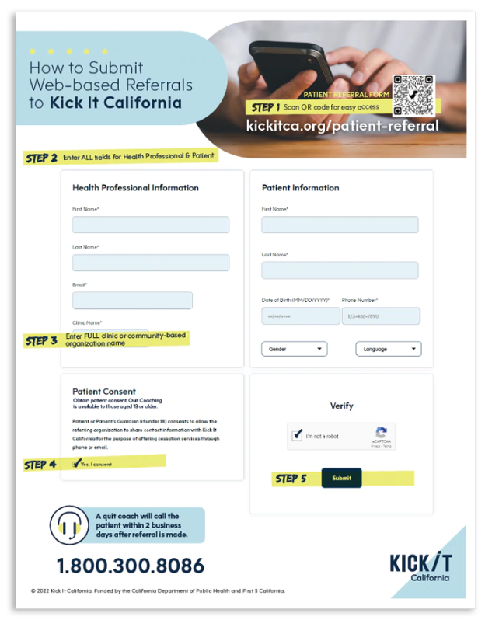

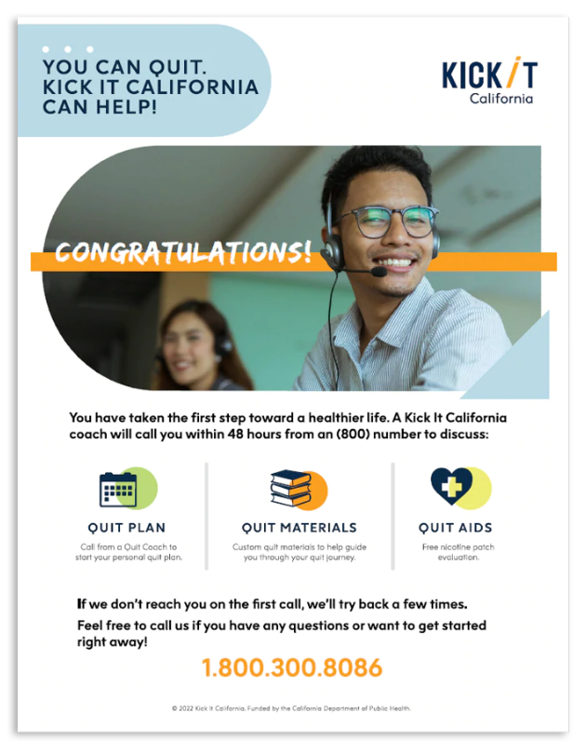
NEED INSPIRATION?
NEED INSPIRATION?
You can check out and download KIC’s promo materials for free from
our materials catalog. Also, you can download our brand elements (logo, colors, other promotional assets) from our brand toolkit brandkickitca.org.
Notes:
ANNA
https://kickitca.myshopify.com/products/how-to-submit-web-based-referrals-to-kick-it-California
https://kickitca.myshopify.com/products/what-to-expect-after-being-referred-to-kic
These are some examples of potential collateral that your clinic can produce. We have a How to Submit referrals to KIC and what to expect after being referred to KIC. I just want to stress on the fact that you should use our materials as inspiration, since you’d probably want to tailor your materials to your clinic’s branding and needs. You also don’t have to include all the information that we list on those flyers or, on the contrary, you can add to the content. We have a KIC brand toolkit brandkickitca.org with all of our brand elements, so you can download our logos and brand colors and use them on your materials for cobranding. If you’d like the communications team to review your materials, feel free to send them our way for feedback.
If a client has further questions, inform them on what will happen next (within 2 business days):
The helpline will call them from a 1-800 number
They will go through an 8-10 min intake.
If they agree to talk further, they can get into a 25-30 min conversation about what’s going to help them quit.
They will talk with a quit coach about the importance of motivation, how to make a solid quit plan to deal with smoking triggers -including quit smoking medications, setting a date, and receiving follow-up support.
If they have questions confidentiality, let them know that it is a web-based system that is encrypted (meaning it is secure) and that the helpline is part of the University of California
San Diego Health System.
After this initial coaching session, our coaches will schedule up to 4 10-minute calls to prevent relapses and promote support and accountability.
Outgoing call number clarification.
English speakers will see 1-800-662-8887 as their caller ID (This is the NO BUTTS line but I took off the vanity number off b/c that does not display on caller ID).
Spanish speakers will see 1-800-600-8191 as long as system knows they are Spanish speaker
1-800-838-8917 (If requested service in Chinese)
1-800-556-5564 (If requested service in Korean)
1-800-778-8440 (If requested service in Vietnamese)
KIC has been having issues with the new phone number for English because it’s registered by some phone carriers as a possible spam number That is why we continue calling back from our former number, so our English-speaking clients will see 1-800-662-8887 as their caller ID. This is just a temporary measure since we are working on fixing this and are also transitioning to a new phone & telecoms system that will hopefully be fully adopted before the end of 2023. Ideally, by then our new number will show as a legit number and ideally show Kick It California as the caller ID. On the other hand, clients who requested service in Spanish will receive a call from 1-800-600-8191. Lastly, same goes our Asian-speaking clients: They will receive a call from 1-800-838-8917 (If requested service in Chinese), 1-800-556-5564 (If requested service in Korean), and 1-800-778-8440 (If requested service in Vietnamese).

Slide 46
Kic brand awareness
In order to raise awareness about our free, nonjudgmental, confidential services and our partnership with HLCI clinics, we recommend you promote or mention the partnership with KIC on your website, social media, and other outreach channels, if possible.
  Follow us and reshare our social media posts
  @kickitca on Facebook, IG, X, and YouTube
  Educational Materials
  Promotional Materials
  Trainings
  Listen to Quit Coaching Sample Calls
  For TA or custom training opportunities,
  email acarbomihalic@health.ucsd.edu
Join our email list to not miss out on our newest cessation news & initiatives!
Notes:
ANNA
Last but not least, I wanted to briefly touch on promoting KIC. In order to raise awareness about our free, nonjudgmental, confidential services and our partnership with HLCI clinics, we recommend you promote or mention the partnership with KIC on your website, social media, and other outreach channels, if possible. However, please be mindful that your promotions should stay within our partnership limits for increased referral outcomes. Which means that if you heavily promote KIC general services (and not the HLCI clinic-specific form) you run the risk on not being able to track the patients that contacted KIC directly and not trough your system. However, that percentage is normally very low. That said, feel free to find inspiration or reshare our social media posts when promoting the partnership, use and customize our educational and promotional materials, watch our available trainings for further cessation information, join our email list to not miss out on our latest news and initiatives and email us for Technical Assistance or custom training opportunities. We’re almost done with the presentation, and we will soon open it up for questions, but before that, Carrie is going to talk about how this joint initiative can become a pilot project in hopes to show proof of concept.
Resources available to clients but also for health professionals and tobacco control & education partners.

Slide 47
Questions?
Thank you!
Questions? Please email
ckirby@health.ucsd.edu

Slide 48
Tobacco Cessation
Promotion & Referrals
November 7, 2023
Notes:
Hi everyone. Thank you for taking the time to learn more about KIC and the Living Healthy Clinic Initiative referral partnership. Today, Carrie Kirby, KIC’s project manager, and myself are going to provide a brief overview about KIC’s free tobacco cessation services and on how to refer your patients to KIC.

Slide 49
AGENDA
About Kick It California
  What is KIC?
  Services & Resources Overview
  Quit Coaching Protocol
The Importance of Proactive Referrals From Providers
  How to talk to patients about quitting smoking (AAR)
  Referring to KIC
How Your Clinic Can Make a Difference
  Promotional Ideas for Distribution of QR Codes & Bitly Links
Notes:
ANNA
This is our agenda for today’s presentation. We’re going to start with a brief introduction of the program KIC, continue with an overview of proactive referrals, our partnership and next steps. If you have any questions during our presentation, please feel free to drop them in the chat box and we will answer them at the end of the training. Before I start touching on these topics, we would really appreciate if you could complete our pre training survey.

Slide 50
About Kick It California
Notes:
ANNA

Slide 51
What is KIC?
FREE statewide cessation program
Started in 1992 by UCSD researchers. Since then,
we have helped nearly a million Californians
Funded by tobacco taxes Props 99, 10 & 56
Validated in randomized controlled trials
Available to ALL California residents
Open Mon-Fri (7am-9pm); Sat (9am-5pm)
Multiple languages: English, Spanish, Mandarin,
Cantonese, Korean, Vietnamese
Notes:
Let’s start with introducing KIC. What is KIC? KIC, previously known as the California Smokers’ Helpline or 1-800 NO BUTTS, is a FREE statewide tobacco cessation program operated by UC San Diego funded by CTCP and First 5 California. Our program, which has been validated in several randomized control trials, is available to ALL California residents and provides quit coaching services in English, Spanish, Mandarin, Cantonese, Korean, and Vietnamese. In our 30 years of history, we've helped 1 million people quit through free, customized, one-on-one coaching that is grounded in science.

Slide 52
Notes:
This graphic helps with displaying a better visual representation of what our brand was and is. On our righthand side you can see the variety of old properties, and on the left, you can see the new streamlined brand experience with just one name, one website in English and Spanish and 2 phone numbers.

Slide 53
Services & resources overview
  Nicotine Patches Availability
  First 5 CA funds
  2-week starter kit of patches
  CDC Grant
    Callers to the Asian Smokers’ Quitline
  Medi-Cal
    Most beneficiaries can get pharmacotherapy covered
    MD prescription needed
    Persons living with children 0-5, Pregnant smokers (with MD approval)
Notes:
CARRIE
Now that I’ve given some background on KIC, I’d like to talk a bit more in detail about the services we provide.
This slide gives you a quick snap shot of our services. As Anna mentioned we were started in 1992 as a telephone counseling service. Since that time we’ve expanded our services and we now offer Chat, Text, Apps videos and Alexa.
We are fortunate that we still have some funding from First 5 and the CDC to provide a 2-week starter kit to a small sub-set of our callers, that is those who have a child 0-5 living in the home or are pregnant and have their MD approval and those who speak one of the Asian languages we serve (Chinese, Korean and Vietnamese).

Slide 54
Who Do We Serve?
Adults (multiple languages, Medi-Cal, range of income, rural & urban, behavioral health, etc.)
Chew/spit tobacco users
Pregnant/nursing women
Teens
Non-tobacco using callers (proxy)
Notes:
CARRIE
KIC serves……

Slide 55
Quit coaching protocol
Intake call
Determine needs, ~6 min. call
First counseling session
Comprehensive, ~30 min. call
Prepare to quit
Set a quit date
Follow-up sessions
Up to four ~10 minute calls
Support and accountability
Relapse prevention
Initial Session
Motivation
Self-efficacy
Smoking & quitting history
Environmental considerations
Treatment overview & rationale
Health considerations
Quitting methods
Self-image
Planning
Call summary
Setting a quit day
Addressing follow-up calls
Notes:
CARRIE
So, what is a typical caller journey look like.
When clients call KIC or are contacted after being referred, we go through a brief intake. This call is 8-10 minutes in length where we determine the client’s needs and find out how we can be helpful. Our goal is to go right into the counseling after this initial intake, otherwise we know we may play phone tag and ultimately loose the client.
The first counseling call is our most comprehensive call and usually lasts about 25-30 minutes. In the call, the counselor strives to help the client build self-confidence, create an individualized plan and motivate them to make a quit attempt and set a quit date.

Slide 56
Proactive Follow-Up Sessions
Motivation & self-efficacy
Quit status
Withdrawal review
Pharmacotherapy review
Challenges & smoking events
Support
Planning for future
Self-image
Notes:
CARRIE
After that initial counseling call, there are up to four follow-up calls.
The follow-up calls are typically much shorter, about 5-10 minutes, during which the counselor strives to convey support and accountability and to help prevent the client from relapsing:
They do this by assessing the client’s motivation level (since this can fluctuate over time) and by
Evaluating how the client’s plan is working and determine if any adjustments are needed
What is also important is how we schedule our follow-up calls. The probability of relapse is the highest within those first few weeks, so we front load our calls. As you can see on this graph on the left, at Day 1 about 10% of people who’ve quit relapse, at Day 7 about 60% have relapsed. So, as I mentioned we front-load our calls. We schedule these 4 follow-up calls Days 1-3, 4-7 and 10-14.
The graph on the right shows a large randomized controlled trial of over 3,000 where we tested self0help materials againse a single session or multiple sessions. As you can see from the graph, the red line had the best quit rates and the self-help group the lowest. Our protocol, multiple sessions, is based on this evidence.

Slide 57
Summary of California Evidence
RCT showed:
  Telephone counseling can increase quit attempts and prevent relapse
  Single session can be efficacious; multiple sessions even more so
Notes:
CARRIE – Maybe mention this or send them these documents in a follow up email or a list of important links
So, briefly telephone counseling can …..
These are some of our publications and we are happy to share them along with others for anyone interested.

Slide 58
The Importance of Proactive
Referrals From Providers
Notes:
Now that we’ve briefly touched on KIC background and services I want to talk about proactive e-referrals. This means that we receive information on a patient instead of the patient reaching out to us.
KIC is being proactive versus reactive (i.e. reacting to the patients call)

Slide 59
Using Ask-Advise-Refer (AAR)
Ask (At every visit, in a caring manner, ask each patient if they smoke/vape)
  Do you (or anyone you live with) smoke?
  How interested are you in quitting?
Advise (without lecturing)
  Quitting is one of the best things you can do for your yourself
  What do you know about how smoking affects health?
  I have some information, if you’d like to hear?
Refer (connect/offer options)
  Refer tobacco users (or those who live with tobacco users) to KIC
  to get a free, one-on-one coaching, and a personal quit plan
  (or a plan to help someone quit) from our trained Quit Coaches
Notes:
CARRIE
We work with healthcare systems, providers, etc. to use the AAR protocol. Ask, Advise and Refer.
Ask – at every visit and it’s important that these questions are open ended
Advise – we still want to provide information but want the information to be tailored to the client’s own goals. We can also ask permission to share information with the client – this communicates respect for the client. Advise patients who smoke/vape to consider quitting
Smoking can lead to or exacerbate health problems such as:
Heart and lung disease
Diabetes
Stroke
Ongoing infections and colds
Cancer
Refer – this is about connecting the client to options in line with their goals - For those who clearly don’t want to quit, don’t insist—the outcome you want is to have a friendly conversation so that they will trust you in the future. Always reiterate that you will continue to inquire about their interest in quitting in future visits and that they may reach out to you when they feel ready. quitting.
Refer (Connect)
If the patient is interested in quitting, congratulate them on their decision. Refer patients willing to quit smoking to:
Kick It California
(formerly known as California Smoker’s Helpline)
1-800-600-8191 • kickitca.org
For those who are not ready to quit or thinking about quitting, they may be ready next time. It is important to avoid being judgmental or trying to pressure the patient into quitting. Offer literature and supportive materials that emphasize the benefits of
BLACK COMMUNITY: Take in account occasional smokers. Assess level of addiction? how quickly upon awakening tobacco is used rather than the number of cigarettes smoked per day. importance of maintaining a high level of motivation throughout a quit attempt. Menthol or not menthol cigarettes. Intentions to quit with their extended family. Identify if spiritual or religious beliefs are a source of support for clients. ◾ Review that spiritual counseling through church may be beneficial during a quit attempt.
Tip #1: Utilize motivational interviewing to assist participants build commitment and reach a decision to change. • Ask permission to talk about their smoking habits. • Ask open-ended questions like, “How do you feel about quitting smoking?” • Help them understand their reasons for quitting. • Be encouraging and empathetic. Stay away from judgement comments.
If ready/not ready to quit
NRT: Decades of research have shown that the most effective way to quit smoking uses a combination of counseling and medications, such as nicotine patches, gum, and lozenges.
As their health care provider or community advisor, communicating with your Latinx patients about their tobacco use and advising them to quit might be one of the most important things you can do for your patient. Smoking is the leading cause of preventable death and ensuring that the patient knows about available help is a first step toward recovery.
According to experts/research
Prevention through education and Promotional efforts to communicate that there are free cessation services. Developing personalized campaign messaging that connects with this audience.

Slide 60
Referring to KIC
Proactive Referrals
Electronic referrals (through health record) or web-based referral
Means Helpline calls the patient – patient doesn’t initiate the call
Workflow for Proactive Referrals:
  Clinic/Hospital:
    Screens patient for tobacco use
    Sends referral to Helpline
KIC:
  Receives patient information
  Attempts patient to try and enroll in services
Notes:
CARRIE
Proactive referrals can be web-based, through the E HR or specific forms created for the organization.

Slide 61
Reasons for e-Referral
Associated with a significantly higher participation rate than simple advice to quit (2-3% vs 40%)
Promotes the use of electronic health records (EHR) to improve healthcare delivery; can help organizations meet various metrics (MU, PRIME, etc.)
Clinical teams can make a big impact on the lives of their patients and reduce health care costs by referring them evidence-based tobacco treatment (i.e. KIC)
Notes:
CARRIE
E-referral to KIC is a very effective method for increasing tobacco interventions and these type of referrals have become so popular over the last few years because of technology and their various benefits. Of which I want to focus on the top three.
Some people are uncomfortable initiating contact with the Quit Line, others forget or lose the phone number
Simple advice to quit results in about 2-3% reach among smokers, while online referral reaches about 40%
For Healthcare Providers:
Incorporates cessation into routine healthcare delivery
Provides opportunity for system change to improve effectiveness, removing time and resource barriers
Assists in meeting quality measures for tobacco cessation
Increases knowledge of latest cessation counseling and pharmacotherapy protocol
Every smoker – Every encounter: ensure that every smoker receives support at every encounter by using the EHR.
Ultimately for Public Health Agencies and Quitlines e-referrals:
Provides cost-effective, sustainable means of reaching more tobacco users
Increases the number of calls received by quitlines
Increases the percent of callers who enroll in quitline services
The Helpline has done a couple of studies about proactive referrals. One of these was the Partnership for Smokefree Families Project (PSF). Doctors told their pregnant smokers to call us and they gave them our number. Only 2-3% called us on their own. We also got direct referrals from the clinics and proactively called, 40% of the group we called agreed to our service.
Another study was conducted in the early 90s when Los Angeles wanted to run their own cessation service. Smokers who called the Helpline and lived in LA were given the info for their county service. We then followed up and found very few actually used the LA service (about 4%).
From March 1999 to Sept 2003, providers referred 2,322 women to CSH. Of these, only 2% called. Among those who did not call the Helpline, Helpline counselors called them – making 5 attempts over different days and times to contact each woman who was referred but who had not called. Through these proactive efforts, the number of women reached rose from 2% to 67%.

Slide 62
Benefits of KIC e-Referral
Documentation
Smoking Status
Reduce provider burden
Off-load work to “experts”
Patients will get the message that staff want to help them quit.
Reach
High risk populations with high tobacco rates that are often served by community clinics
Consistent with AAFP recommended tobacco practices
Can be incorporated into interventions for behavioral health patients, who have the highest rates of tobacco use
Tobacco Interventions
Notes:
CARRIE

Slide 63
Population Health Strategy
IT folks generate a list of members/patients who smoke or vape
  Identify using ICD-11 coding, assessments, pharmacy records, etc.
Securely share with KIC
KIC uploads the data and begins outreach to members/patients
Goal – enroll in services
  At a minimum reach member/patient and share resources available

Slide 64
Pilot Data
 | Total |  |  | Health Net |  |  | LA Care
Unique referral |  | 4474 |  |  | 2399 |  |  | 2074
Intake | 4474 | 169 | 3.8% | 2399 | 109 | 4.5% | 2074 | 59 | 2.8%
Counseling | 169 | 78 | 46.2% | 109 | 51 | 46.8% | 59 | 27 | 45.8%
Follow-up calls | 78 | 39 | 50.0% | 51 | 25 | 49.0% | 26 | 14 | 53.8%
# of FU calls | 39 |  | 1.95 | 25 |  | 1.96 | 14 |  | 1.93

Slide 65
Reach Rate
Liberal – anyone we speak to (which includes people who decline our services), leave a message, or enroll in program
  Range 78-79%
Conservative – only those who we enroll or we speak to
  Range 40-44%

Slide 66
How Your Clinic Can Make a Difference

Slide 67
Promotional ideas
Produce signage with a QR code and place it around the clinic so patients that are waiting can scan the code and enroll in the program
Create support materials
  To encourage the patients to enroll via QR code/short link
  To let them know what to expect after being referred
Text/email out bitly link
After Visit Summary
  List phone number, KIC, etc.
Send MyChart (or message through EHR)
  Helps prime the patient so when KIC calls doesn’t feel like a cold call
Use QR code in traditional mail to follow up about a visit,
reminders, surveys etc.
Notes:
ANNA
Regarding promotional initiatives, here are some of our suggestions/recs, but please feel free to share your ideas with us at the end of the presentation or in the chat so we can reach as many patients who use tobacco and get as many referrals as possible. Something that can ultimately have a positive impact on the health and wellbeing of our communities.
First of all, we recommend that you produce signage with the QR code and place it around the clinic so patients that are waiting can scan the code and enroll in the program - Those could be posters, office signs, banners, a-frames, you name it.
Creating support materials with information on how to enroll in the program with the QR code (if printed) and with bitly link (if digital) is also important
We also recommend making collateral on what to expect after being referred to KIC or you can use and cobrand KIC’s flyers that I will show in the next slide
Texting out the bitly link to patients that have been identified as tobacco users is a great strategy to get more patients to enroll in the program
Another idea is to include our QR code or short link in the after-visit summary as well as sending MyChart messages or messages through EHR with KIC information and codes or what to expect information, so the patient gets familiar with the program before they get contacted.
Lastly, we think adding the QR code in traditional mail addressed to a patient who smokes, vapes, or uses smokeless tobacco can have a positive outcome. These letters can be follow-ups about a visit, other reminders, customer satisfaction surveys, etc.

Slide 68
NEED INSPIRATION?
NEED INSPIRATION?
You can check out and download KIC’s promo materials for free from
our materials catalog. Also, you can download our brand elements (logo, colors, other promotional assets) from our brand toolkit brandkickitca.org.
Notes:
ANNA
https://kickitca.myshopify.com/products/how-to-submit-web-based-referrals-to-kick-it-California
https://kickitca.myshopify.com/products/what-to-expect-after-being-referred-to-kic
These are some examples of potential collateral that your clinic can produce. We have a How to Submit referrals to KIC and what to expect after being referred to KIC. I just want to stress on the fact that you should use our materials as inspiration, since you’d probably want to tailor your materials to your clinic’s branding and needs. You also don’t have to include all the information that we list on those flyers or, on the contrary, you can add to the content. We have a KIC brand toolkit brandkickitca.org with all of our brand elements, so you can download our logos and brand colors and use them on your materials for cobranding. If you’d like the communications team to review your materials, feel free to send them our way for feedback.
If a client has further questions, inform them on what will happen next (within 2 business days):
The helpline will call them from a 1-800 number
They will go through an 8-10 min intake.
If they agree to talk further, they can get into a 25-30 min conversation about what’s going to help them quit.
They will talk with a quit coach about the importance of motivation, how to make a solid quit plan to deal with smoking triggers -including quit smoking medications, setting a date, and receiving follow-up support.
If they have questions confidentiality, let them know that it is a web-based system that is encrypted (meaning it is secure) and that the helpline is part of the University of California
San Diego Health System.
After this initial coaching session, our coaches will schedule up to 4 10-minute calls to prevent relapses and promote support and accountability.
Outgoing call number clarification.
English speakers will see 1-800-662-8887 as their caller ID (This is the NO BUTTS line but I took off the vanity number off b/c that does not display on caller ID).
Spanish speakers will see 1-800-600-8191 as long as system knows they are Spanish speaker
1-800-838-8917 (If requested service in Chinese)
1-800-556-5564 (If requested service in Korean)
1-800-778-8440 (If requested service in Vietnamese)
KIC has been having issues with the new phone number for English because it’s registered by some phone carriers as a possible spam number That is why we continue calling back from our former number, so our English-speaking clients will see 1-800-662-8887 as their caller ID. This is just a temporary measure since we are working on fixing this and are also transitioning to a new phone & telecoms system that will hopefully be fully adopted before the end of 2023. Ideally, by then our new number will show as a legit number and ideally show Kick It California as the caller ID. On the other hand, clients who requested service in Spanish will receive a call from 1-800-600-8191. Lastly, same goes our Asian-speaking clients: They will receive a call from 1-800-838-8917 (If requested service in Chinese), 1-800-556-5564 (If requested service in Korean), and 1-800-778-8440 (If requested service in Vietnamese).

Slide 69
Kic brand awareness
In order to raise awareness about our free, nonjudgmental, confidential services and our partnership with HLCI clinics, we recommend you promote or mention the partnership with KIC on your website, social media, and other outreach channels, if possible.
  Follow us and reshare our social media posts
  @kickitca on Facebook, IG, X, and YouTube
  Educational Materials
  Promotional Materials
  Trainings
  Listen to Quit Coaching Sample Calls
  For TA or custom training opportunities,
  email acarbomihalic@health.ucsd.edu
Join our email list to not miss out on our newest cessation news & initiatives!
Notes:
ANNA
Last but not least, I wanted to briefly touch on promoting KIC. In order to raise awareness about our free, nonjudgmental, confidential services and our partnership with HLCI clinics, we recommend you promote or mention the partnership with KIC on your website, social media, and other outreach channels, if possible. However, please be mindful that your promotions should stay within our partnership limits for increased referral outcomes. Which means that if you heavily promote KIC general services (and not the HLCI clinic-specific form) you run the risk on not being able to track the patients that contacted KIC directly and not trough your system. However, that percentage is normally very low. That said, feel free to find inspiration or reshare our social media posts when promoting the partnership, use and customize our educational and promotional materials, watch our available trainings for further cessation information, join our email list to not miss out on our latest news and initiatives and email us for Technical Assistance or custom training opportunities. We’re almost done with the presentation, and we will soon open it up for questions, but before that, Carrie is going to talk about how this joint initiative can become a pilot project in hopes to show proof of concept.
Resources available to clients but also for health professionals and tobacco control & education partners.

Slide 70
Questions?
Thank you!
Questions? Please email
ckirby@health.ucsd.edu

