Slide 1

Tobacco cessation resources, promotion & referrals
Notes:
CARRIE
Hi everyone, I’m Carrie Kirby. Thank you for taking the time to learn more about KIC services, promotion and cessation referrals. Today, Dr. Rina Edi , and myself, are going to provide a brief overview about KIC’s free tobacco cessation services and on how to refer patients to KIC.

Slide 2
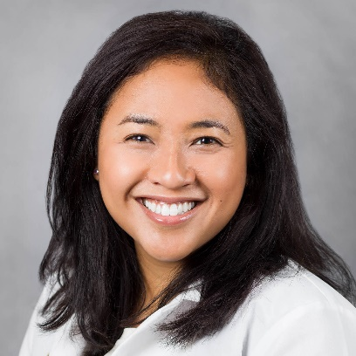

WELCOME!
Presenter
Dr. Rina Edi, M.D.
Medical Director, Kick It California
University of California San Diego
Presenter
Carrie Kirby
Project Manager, Kick It California
University of California San Diego
Notes:
CARRIE
And now, a little introduction about us. Dr. Rina Edi is a Family Medicine Doctor at UCSD and Medical Director for Kick It California. She’s been at KIC for 6 years and her interests include teaching medical students, residents and other faculty about smoking and vaping cessation and the importance of addressing cessation with patients and how it can impact their health. She’s also interested in working with healthcare systems to increase referrals to KIC.
A little about me, my name is Carrie Kirby. I’m a Project Manager at Kick It California. I’ve been with the program for over 20 years, serving as project manager for various randomized controlled trials looking at tobacco use among vulnerable and underserved populations, like pregnant women and low-income groups. My current interest is working with health care systems to ensure tobacco screenings are done at every encounter. This includes working with organizations to integrate a KIC referral within their electronic health record.
Proactive referrals increase the numbers of smokers getting service, something that increases the number of smokers quitting, which ultimately decreases healthcare costs, saves lives, and makes the population healthier.

Slide 3

AGENDA
About Kick It California
What is KIC?
Services & Resources Overview
Quit Coaching Protocol
The Importance of Proactive Referrals From Providers
How to talk to patients about quitting smoking (AAR)
Referring to KIC
How Providers Can Make a Difference
Promotional Ideas for Distribution of QR Codes
Notes:
CARRIE
This is our agenda for today’s presentation. We’re going to start with a brief introduction of the program KIC, continue with an overview of proactive referrals, our partnership and next steps. If you have any questions during our presentation, please feel free to drop them in the chat box and we will answer them at the end of the training. Before we start, we’d really appreciate if you could complete our pre training survey.

Slide 4

Pre-training survey
https://ucsd.co1.qualtrics.com/jfe/form/SV_0O5pA3O97HyMWN0
Notes:
CARRIE
Please go to the link or scan the QR code. I’ll just wait a couple of minutes so you can complete the survey. We really appreciate your time completing this poll.

Slide 5

About Kick It California
Notes:
CARRIE
Ok, let’s get started

Slide 6
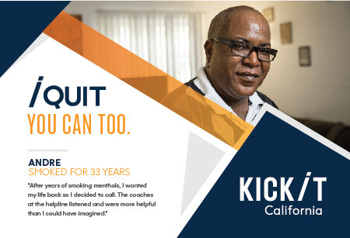
What is KIC?
FREE statewide cessation program
Started in 1992 by UCSD researchers. Since then, we have helped nearly a million Californians
Funded by tobacco taxes Props 99, 10 & 56
Validated in randomized controlled trials
Available to ALL California residents
Open Mon-Fri (7am-9pm); Sat (9am-5pm)
Multiple languages: English, Spanish, Mandarin, Cantonese, Korean, Vietnamese
Notes:
CARRIE
What is KIC? KIC, previously known as the California Smokers’ Helpline or 1-800 NO BUTTS, is a FREE statewide tobacco cessation program operated by UC San Diego funded by CTCP and First 5 California. Our program, which has been validated in several randomized control trials, is available to ALL California residents and provides quit coaching services in English, Spanish, Mandarin, Cantonese, Korean, and Vietnamese. We are open Mon-Fri 7am-9pm and Sat 9am-5pm. After hours, callers are able to leave a message. In our 30 years of history, we've helped 1 million people quit through free, customized, one-on-one coaching that is grounded in science.

Slide 7

History
Notes:
CARRIE
In 2022 KIC turned 30 and here’s a brief video about KIC’s history which highlights the program’s milestones.

Slide 8
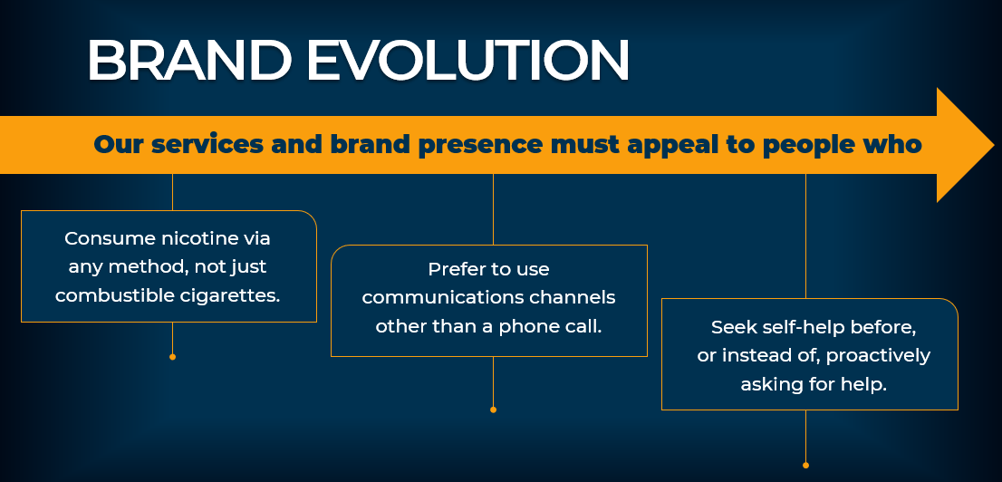


Brand Evolution
In 2020, the California Smokers’ Helpline, in consultation with our funder, CTCP, completed a 3-month discovery period led by a creative agency.
We conducted focus groups and surveys of people who smoke and vape, as well as our quit coaches; and we met with our funders and advocates across the tobacco control community to inform this evolution.
Notes:
CARRIE
I’ll briefly touch on the rebrand. Some of you might not be familiar with the brand KIC, however, you might recognize the name 1800 NO BUTTS or the California Smokers Helpline.
In 2020, the California Smokers’ Helpline, in consultation with our funder, CTCP, completed a 3-month discovery period led by a creative agency.
We conducted focus groups and surveys of people who smoke and vape, as well as our quit coaches; and we met with our funders and advocates across the tobacco control community to inform this evolution.
For 2 ½ years, since September 2021, the Helpline has been operating as Kick It California:
New phone numbers
New properties
Rebranded social media pages
New & rebranded Print & digital materials
New website kickitca.org in Eng & Spa

Slide 9
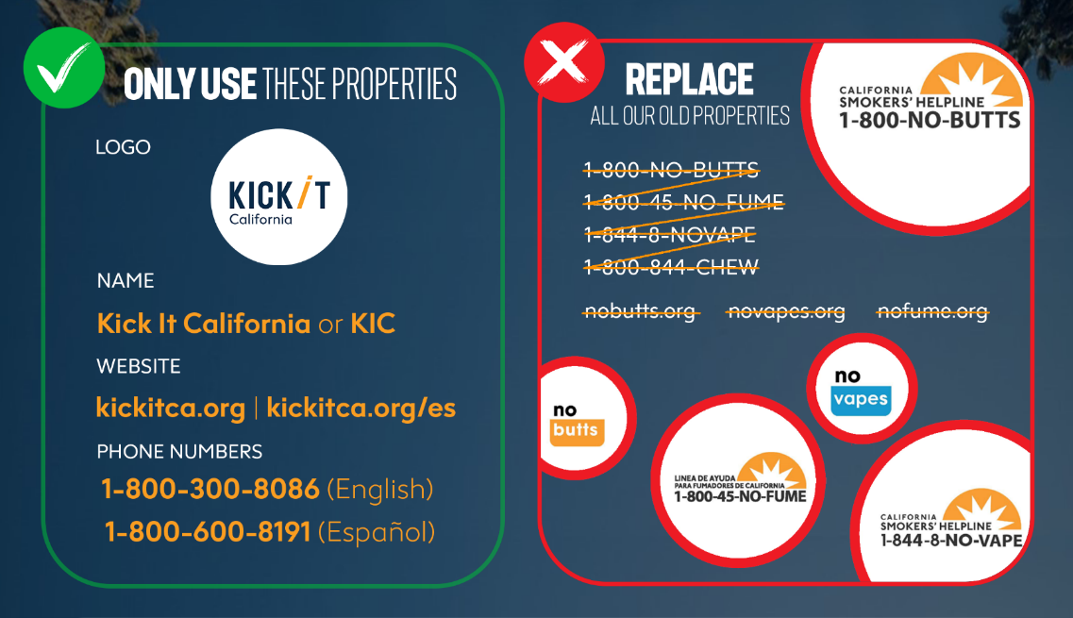
Notes:
CARRIE
This graphic helps with displaying a better visual representation of what our brand was and currently is. On our righthand side you can see the variety of old properties, and on the left, you can see the new streamlined brand experience with just one name, one website in English and Spanish and 2 phone numbers.

Slide 10
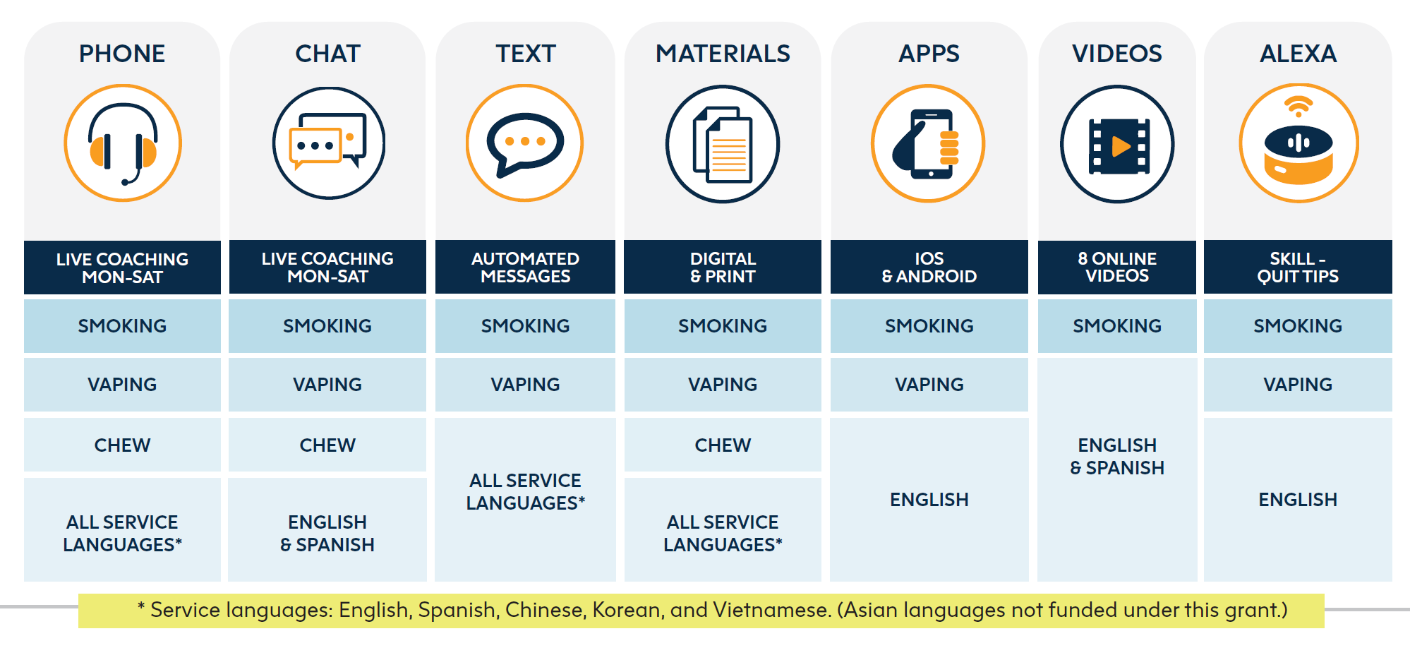
Services & resources overview
Nicotine Patches Availability
First 5 CA funds – 2-week starter kit of patches
Persons living with children 0-5, Pregnant smokers (with MD approval)
Medi-Cal
Most beneficiaries can get pharmacotherapy covered
MD prescription needed
Notes:
RINA

Slide 11
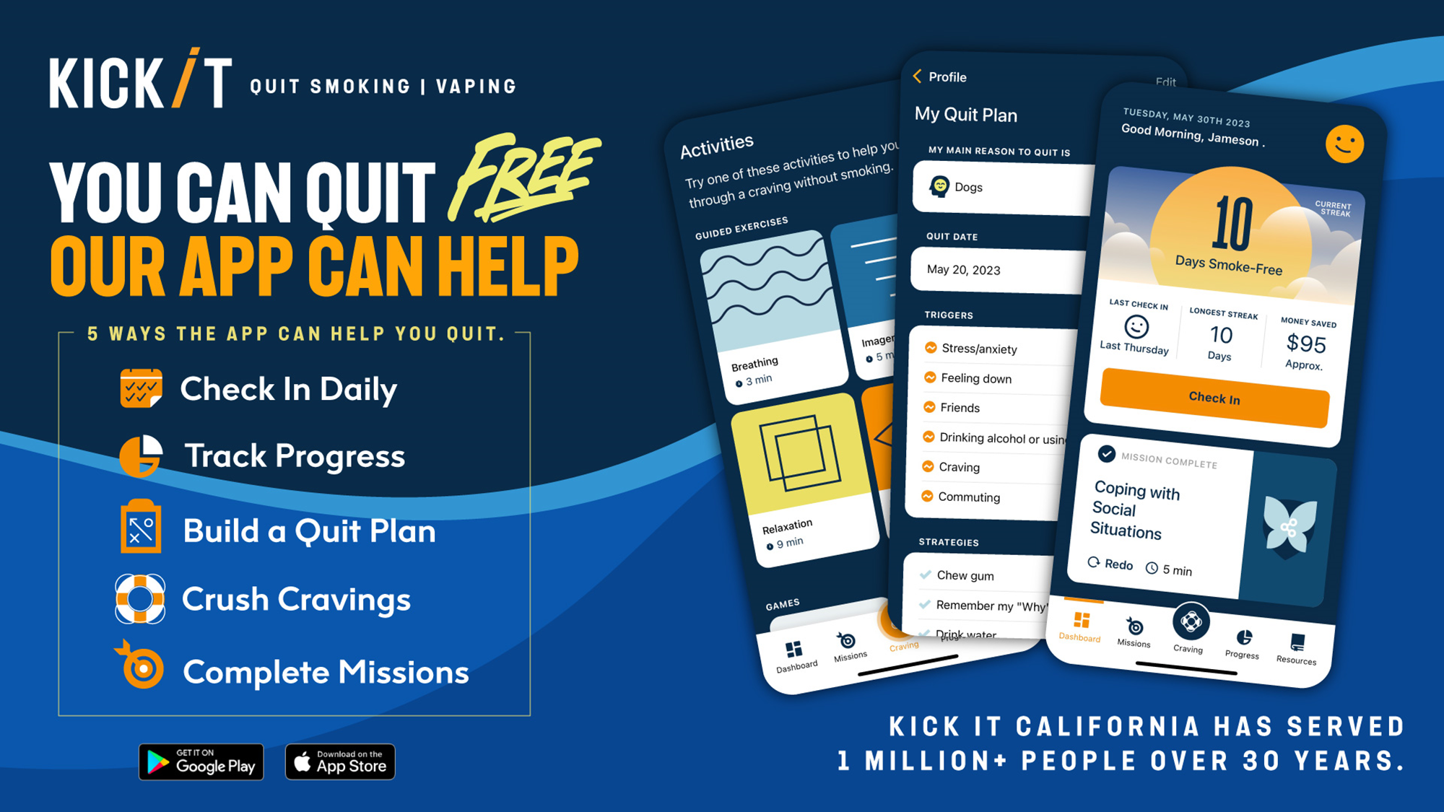
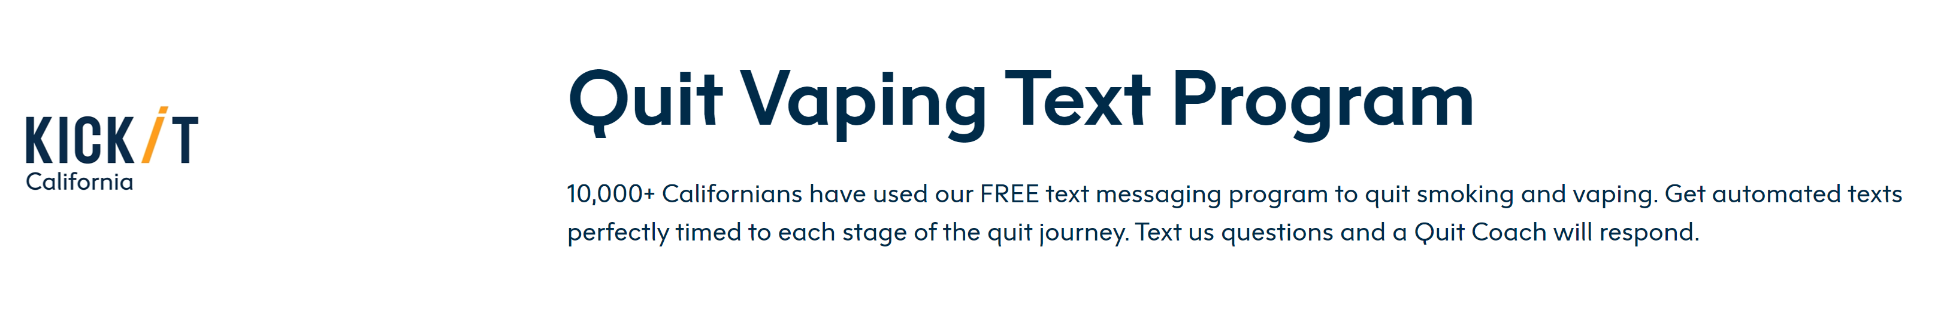
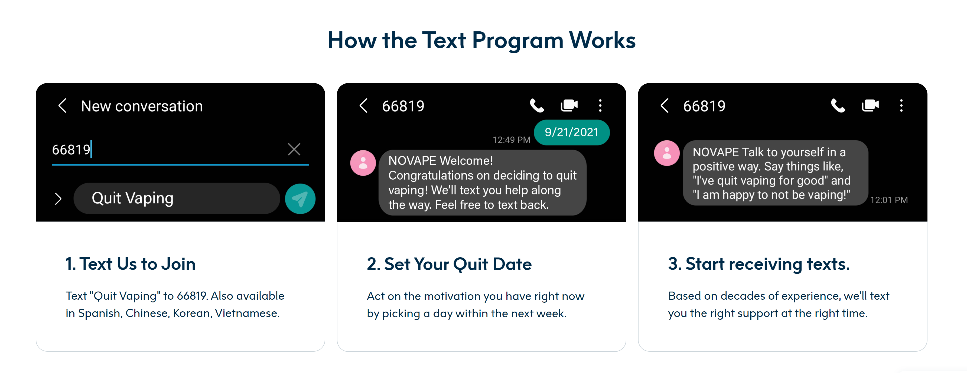
Notes:
RINA

Slide 12
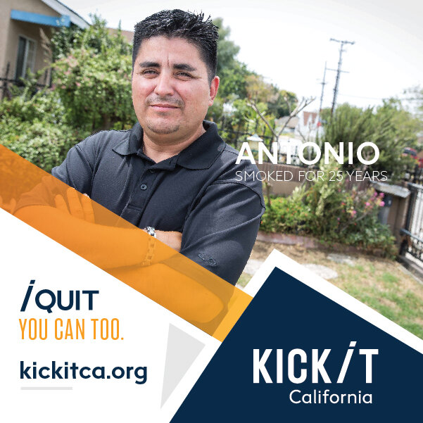
Who Do We Serve?
Adults (multiple languages, Medi-Cal, range of income, rural & urban, behavioral health, etc.)
Chew/spit tobacco users
Pregnant/nursing women
Teens
Non-tobacco using callers (proxy)
Notes:
RINA

Slide 13
Teen Population
Serve teens aged 13 years and older
Confidential
No parental consent needed
Coaches trained in teen smoking cessation and vaping cessation
Notes:
RINA

Slide 14
Quit coaching protocol
Intake call
Determine needs, ~6 min. call
First counseling session
Comprehensive, ~30 min. call
Prepare to quit
Set a quit date
Follow-up sessions
Up to four ~10 minute calls
Support and accountability
Relapse prevention
Initial Session
Motivation
Self-efficacy
Smoking & quitting history
Environmental considerations
Treatment overview & rationale
Health considerations
Quitting methods
Self-image
Planning
Call summary
Setting a quit day
Addressing follow-up calls
Notes:
RINA

Slide 15
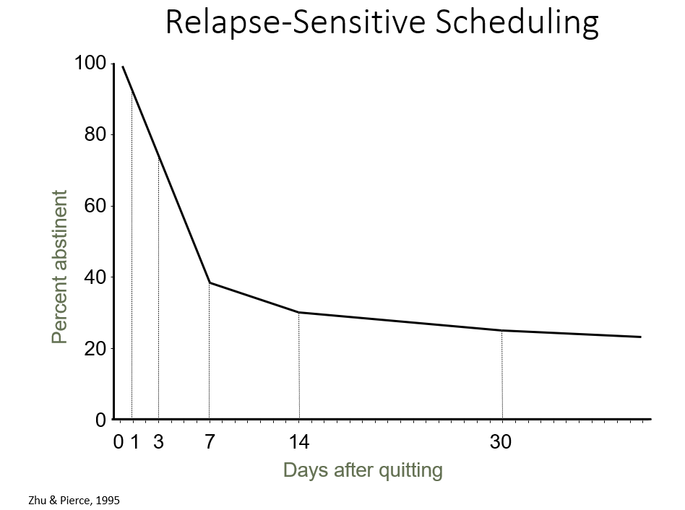
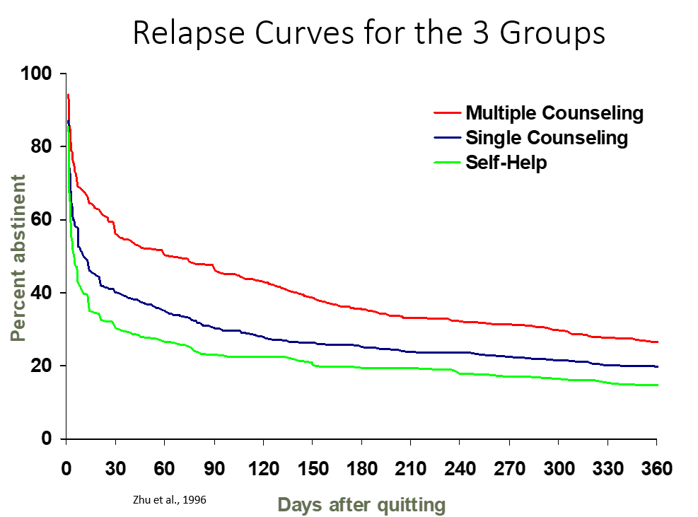
Proactive Follow-Up Sessions
Motivation & self-efficacy
Quit status
Withdrawal review
Pharmacotherapy review
Challenges & smoking events
Support
Planning for future
Self-image
Notes:
RINA

Slide 16
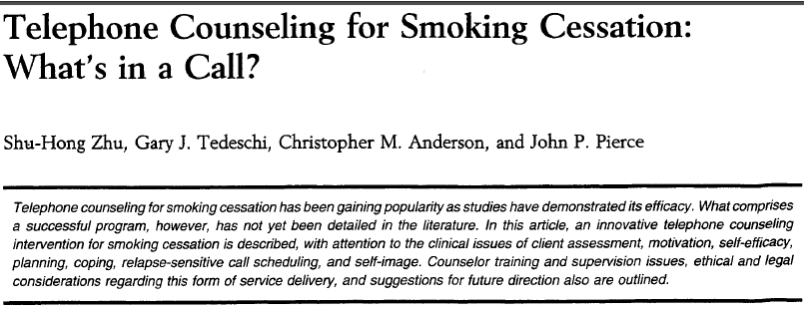
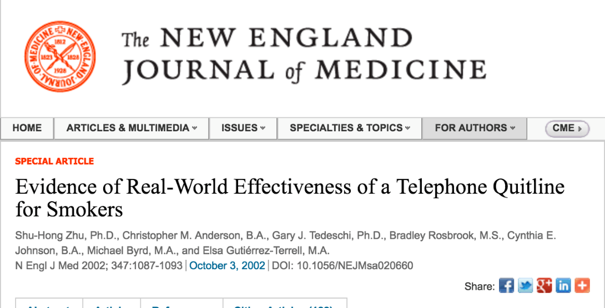
Summary of California Evidence
RCT showed:
Telephone counseling can increase quit attempts and prevent relapse
Single session can be efficacious; multiple sessions even more so
Notes:
RINA

Slide 17

The Importance of Proactive Referrals From Providers
Notes:
RINA

Slide 18



Using Ask-Advise-Refer (AAR)
Ask (At every visit, in a caring manner, ask each patient if they smoke/vape)
Do you (or anyone you live with) smoke?
How interested are you in quitting?
Advise (without lecturing)
Quitting is one of the best things you can do for your yourself
What do you know about how smoking affects health?
I have some information, if you’d like to hear?
Refer (connect/offer options)
Refer tobacco users (or those who live with tobacco users) to KIC to get a free, one-on-one coaching, and a personal quit plan (or a plan to help someone quit) from our trained Quit Coaches
Notes:
RINA
With Ask – important that these are open ended
Advise – we still want to provide information but want the information to be tailored to the client’s own goals. We can also ask permission to share information with the client – this communicates respect for the client. Advise patients who smoke/vape to consider quitting
Smoking can lead to or exacerbate health problems such as:
Heart and lung disease
Diabetes
Stroke
Ongoing infections and colds
Cancer
Refer – this is about connecting the client to options in line with their goals - For those who clearly don’t want to quit, don’t insist—the outcome you want is to have a friendly conversation so that they will trust you in the future. Always reiterate that you will continue to inquire about their interest in quitting in future visits and that they may reach out to you when they feel ready. quitting.
Refer (Connect)
If the patient is interested in quitting, congratulate them on their decision. Refer patients willing to quit smoking to:
Kick It California
(formerly known as California Smoker’s Helpline)
1-800-600-8191 • kickitca.org
For those who are not ready to quit or thinking about quitting, they may be ready next time. It is important to avoid being judgmental or trying to pressure the patient into quitting. Offer literature and supportive materials that emphasize the benefits of
BLACK COMMUNITY: Take in account occasional smokers. Assess level of addiction? how quickly upon awakening tobacco is used rather than the number of cigarettes smoked per day. importance of maintaining a high level of motivation throughout a quit attempt. Menthol or not menthol cigarettes. Intentions to quit with their extended family. Identify if spiritual or religious beliefs are a source of support for clients. ◾ Review that spiritual counseling through church may be beneficial during a quit attempt.
Tip #1: Utilize motivational interviewing to assist participants build commitment and reach a decision to change. • Ask permission to talk about their smoking habits. • Ask open-ended questions like, “How do you feel about quitting smoking?” • Help them understand their reasons for quitting. • Be encouraging and empathetic. Stay away from judgement comments.
If ready/not ready to quit
NRT: Decades of research have shown that the most effective way to quit smoking uses a combination of counseling and medications, such as nicotine patches, gum, and lozenges.
As their health care provider or community advisor, communicating with your Latinx patients about their tobacco use and advising them to quit might be one of the most important things you can do for your patient. Smoking is the leading cause of preventable death and ensuring that the patient knows about available help is a first step toward recovery.
According to experts/research
Prevention through education and Promotional efforts to communicate that there are free cessation services. Developing personalized campaign messaging that connects with this audience.

Slide 19
Referring to KIC
Proactive Referrals
Electronic referrals (through health record) or web-based referral
Means Helpline calls the patient – patient doesn’t initiate the call
Workflow for Proactive Referrals:
Clinic/Hospital:
Screens patient for tobacco use
Sends referral to KIC
KIC:
Receives patient information
Attempts patient to try and enroll in services
Notes:
RINA
Now that I briefly touched about KIC’s services I want to talk about proactive e-referrals. This means that we receive information on a patient instead of the patient reaching out to us.
KIC is being proactive versus reactive (i.e. reacting to the patients call)

Slide 20





Reasons for e-Referral
Associated with a significantly higher participation rate than simple advice to quit (2-3% vs 40%)
Promotes the use of electronic health records (EHR) to improve healthcare delivery; can help organizations meet various metrics (MU, PRIME, etc.)
Clinical teams can make a big impact on the lives of their patients and reduce health care costs by referring them evidence-based tobacco treatment (i.e. KIC)
Notes:
RINA
E-referral to the Helpline is a very effective method for increasing tobacco interventions and these type of referrals have become so popular over the last few years because of technology and their various benefits. Of which I want to focus on the top three.
Some people are uncomfortable initiating contact with the Quit Line, others forget or lose the phone number
Simple advice to quit results in about 2-3% reach among smokers, while online referral reaches about 40%
For Healthcare Providers:
Incorporates cessation into routine healthcare delivery
Provides opportunity for system change to improve effectiveness, removing time and resource barriers
Assists in meeting quality measures for tobacco cessation
Increases knowledge of latest cessation counseling and pharmacotherapy protocol
Every smoker – Every encounter: ensure that every smoker receives support at every encounter by using the EHR.
Uliymatey for Public Health Agencies and Quitlines e-referrals:
Provides cost-effective, sustainable means of reaching more tobacco users
Increases the number of calls received by quitlines
Increases the percent of callers who enroll in quitline services
The Helpline has done a couple of studies about proactive referrals. One of these was the Partnership for Smokefree Families Project (PSF). Doctors told their pregnant smokers to call us and they gave them our number. Only 2-3% called us on their own. We also got direct referrals from the clinics and proactively called, 40% of the group we called agreed to our service.
Another study was conducted in the early 90s when Los Angeles wanted to run their own cessation service. Smokers who called the Helpline and lived in LA were given the info for their county service. We then followed up and found very few actually used the LA service (about 4%).
From March 1999 to Sept 2003, providers referred 2,322 women to CSH. Of these, only 2% called. Among those who did not call the Helpline, Helpline counselors called them – making 5 attempts over different days and times to contact each woman who was referred but who had not called. Through these proactive efforts, the number of women reached rose from 2% to 67%.

Slide 21
Background of e-Referral
2013
Began electronic referrals (e-Referral) in 2013 with UC Davis
2014
Expanded to 3 additional 3 UC’s in 2014 and a 4th in 2015
2015
Designated as Specialized Registry in 2015
2016
Since 2016 partnered with over 80 clinics, hospitals, etc. to implement e-Referral program
Notes:
CARRIE
This slide shows the evolution of our electronic referrals with healthcare providers. We began as a grant funded project with UC Davis in 2013. We then expanded to 3 additional UC’s in 2014 and a 5th in 2015. In 2015 we were designated as a specialized registry and helped organizations meet meaningful use metrics which then became MIPS, then PRIME and is now QIP (or Quality Incentive Program). Since 2016, we’ve partnered with over 80 organizations to implement an e-referral program.

Slide 22
Referrals Over Time
Notes:
CARRIE
This shows referrals over time and as you can see it was a steady increase as we began partnering with organizations. Then took a huge dip during the pandemic and has began increasing again. However, we are starting to see a bit of a plateau and want to see the continual increase, so we are reaching back out to organizations to see how we can help them increase their referrals to KIC.

Slide 23
Partnership
Between administrative and IT teams from clinic/hospital and KIC
Goals
Help clinic/hospital meet reporting metrics
Increase referrals to Kick It California
Increase cessation
Decrease healthcare costs
Notes:
CARRIE

Slide 24

How Providers Can Make a Difference

Slide 25
Promotional ideas
Produce signage with the QR code and place it around the clinic so patients that are waiting can scan the code and enroll in the program
Create support materials
To encourage the patients to enroll via QR code/short link
To let them know what to expect after being referred
Text out bitly link
After Visit Summary
List phone number, KIC, etc.
Send MyChart (or message through EHR)
Helps prime the patient so when KIC calls doesn’t feel like a cold call
Use QR code in traditional mail to follow up about a visit, reminders, surveys etc.
Notes:
CARRIE
Regarding promotional initiatives, here are some of our suggestions/recs, but please feel free to share your ideas with us at the end of the presentation or in the chat so we can reach as many people who use tobacco and get as many referrals as possible. Something that can ultimately have a positive impact on the health and wellbeing of our communities.
First of all, we can produce flyers with QR codes that can be placed around clinics so patients that are waiting can scan the code and self-enroll in the program - Those could be posters, office signs, banners, a-frames, you name it.
Creating support materials with information on how to enroll in the program with the QR code (if printed) and with bitly link (if digital) is also important
We also recommend making collateral on what to expect after being referred to KIC or you can use and cobrand KIC’s flyers that I will show in the next slide
Texting out the bitly link to patients that have been identified as tobacco users is a great strategy to get more patients to enroll in the program
Another idea is to include our QR code or short link in the after-visit summary as well as sending MyChart messages or messages through EHR with KIC information and codes or what to expect information, so the patient gets familiar with the program before they get contacted.
Lastly, we think adding the QR code in traditional mail addressed to a patient who smokes, vapes, or uses smokeless tobacco can have a positive outcome. These letters can be follow-ups about a visit, other reminders, customer satisfaction surveys, etc.

Slide 26
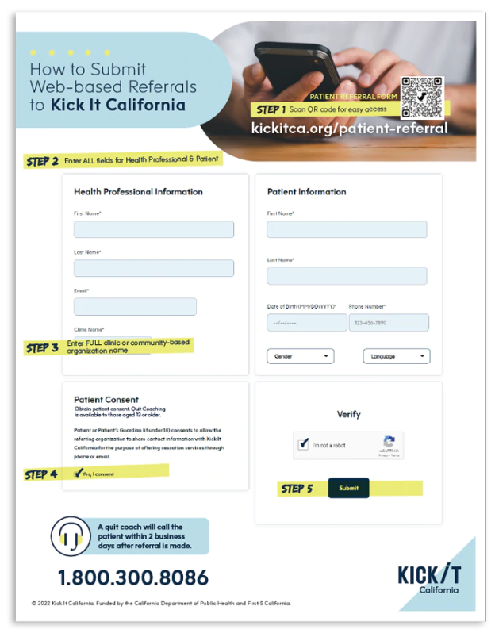


NEED INSPIRATION?
NEED INSPIRATION?
You can check out and download KIC’s promo materials for free from our materials catalog. Also, you can download our brand elements (logo, colors, other promotional assets) from our brand toolkit brandkickitca.org.
Notes:
CARRIE
https://kickitca.myshopify.com/products/how-to-submit-web-based-referrals-to-kick-it-California
https://kickitca.myshopify.com/products/what-to-expect-after-being-referred-to-kic
These are some examples of potential collateral that your clinic can produce. We have a How to Submit referrals to KIC and what to expect after being referred to KIC. I just want to stress on the fact that you should use our materials as inspiration, since you’d probably want to tailor your materials to your clinic’s branding and needs. You also don’t have to include all the information that we list on those flyers or, on the contrary, you can add to the content. We have a KIC brand toolkit brandkickitca.org with all of our brand elements, so you can download our logos and brand colors and use them on your materials for cobranding. If you’d like the communications team to review your materials, feel free to send them our way for feedback.
If a client has further questions, inform them on what will happen next (within 2 business days):
The helpline will call them from a 1-800 number
They will go through an 8-10 min intake.
If they agree to talk further, they can get into a 25-30 min conversation about what’s going to help them quit.
They will talk with a quit coach about the importance of motivation, how to make a solid quit plan to deal with smoking triggers -including quit smoking medications, setting a date, and receiving follow-up support.
If they have questions confidentiality, let them know that it is a web-based system that is encrypted (meaning it is secure) and that the helpline is part of the University of California San Diego Health System.
After this initial coaching session, our coaches will schedule up to 4 10-minute calls to prevent relapses and promote support and accountability.

Slide 27


Promoting Kick It California
In order to raise awareness about our free, nonjudgmental, confidential services, we recommend you promote or mention KIC on your website, social media, and other outreach channels, if possible.
Follow us and reshare our social media posts @kickitca on Facebook, IG, Twitter, and YouTube
Educational Materials
Promotional Materials
Trainings
Join our Email List
For TA or custom training opportunities, email cshoutreach@ucsd.edu
Join our email list to not miss out on our newest cessation news & initiatives!
Notes:
CARRIE
Finally, I wanted to briefly touch on promoting KIC. In order to raise awareness about our free, nonjudgmental, confidential services, we recommend you promote KIC on your website, social media, and other outreach channels, if possible. Feel free to find inspiration or reshare our social media posts when promoting, use and customize our educational and promotional materials, watch our available trainings for further cessation information, join our email list to not miss out on our latest news and initiatives and email us for Technical Assistance or custom training opportunities.
We’re almost done with the presentation, and we will soon open it up for questions.

Slide 28

Post-training survey
https://ucsd.co1.qualtrics.com/jfe/form/SV_85Fccwp1AVnvrxA
Notes:
CARRIE
If you can please fill out the post training survey, we would greatly appreciate it.

Slide 29

Questions?
Notes:
CARRIE
Now, for questions ☺

Slide 30

Thank you!
Questions? Please email
ckirby@health.ucsd.edu
redi@health.ucsd.edu
Notes:
Thank you again for taking the time today to learn about KIC. We appreciate and are hear to help support your tobacco cessation efforts.

