Slide 1


Tobacco Cessation:
KIC Services &
Referral Options
Carrie Kirby, M.S. Project Manager
Notes:
Hi everyone. Thank you for taking the time to learn more about KIC services and referral options. My name is Carrie Kirby and I’m a project manager here at Kick It California. In this quick video I’ll be giving a brief overview about KIC’s free tobacco cessation services and how to refer patients to KIC. Thanks for coming along with me.

Slide 2

AGENDA
About Kick It California
Who is KIC
Services Overview
The Importance of Proactive Referrals From Providers
Referring to KIC
How Providers Can Make a Difference
Promotional Ideas for Distribution of QR Codes
Notes:
Let’s jump right in to our agenda. As I mentioned I’ll give some background on KIC services, the importance of proactive referrals and how to refer

Slide 3

About Kick It California

Slide 4
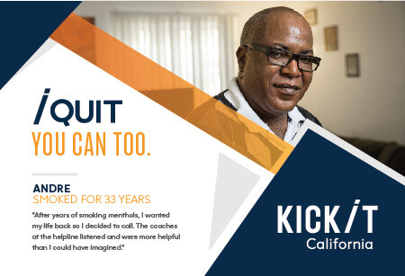
What is KIC?
FREE statewide cessation program
Started in 1992 by UCSD researchers. Since then, we have helped nearly a million Californians
Funded by tobacco taxes Props 99, 10 & 56
Validated in randomized controlled trials
Available to ALL California residents
Open Mon-Fri (7am-9pm); Sat (9am-5pm)
Multiple languages: English, Spanish, Mandarin, Cantonese, Korean, Vietnamese
Notes:
Kick It California, formerly known as the California Smokers’ Helpline, is a free tobacco cessation program operated by UC San Diego. We offer services for those who want to quit smoking, vaping or using smokeless tobacco.
Our services are FREE of charge to anyone living within California. We started in 19992 by UCSD researchers and have helped nearly a million people. We are funded by tobacco taxes. Our program protocol focuses on motivation, ambivalence, planning and skill-building. It’s been rigorously tested in several large, randomized trials, and has been shown to double a tobacco user’s chance of quitting.
We are open weekdays from 7am-9pm and on Sat from 9am-5pm.
We offer coaching in English, Spanish, Mandarin, Cantonese, Korean, and Vietnamese. All of our coaches undergo rigorous training and apprenticeships, participate in weekly monitoring and case reviews, and attend continuing education courses on cultural awareness.

Slide 5
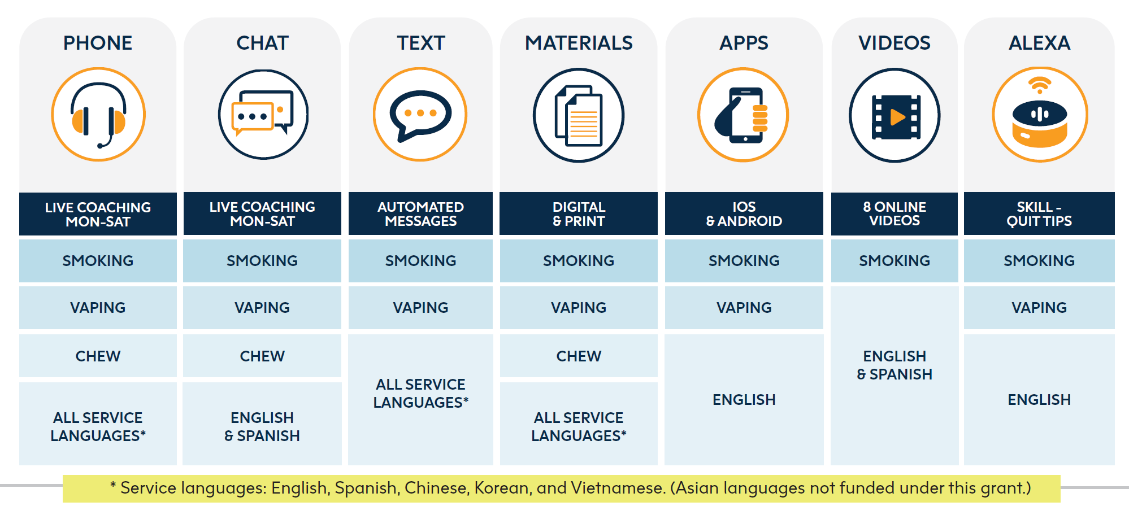
Services & resources overview
Nicotine Patches Availability
First 5 CA funds – 2-week starter kit of patches
Persons living with children 0-5, Pregnant smokers (with MD approval)
Medi-Cal
Most beneficiaries can get pharmacotherapy covered
MD prescription needed
Notes:
Although we were initially established as a telephone service, we’ve expanded our services to include other modalities. KIC now offers phone, chat, text, materials, apps, quit videos and an alexa skill.

Slide 6
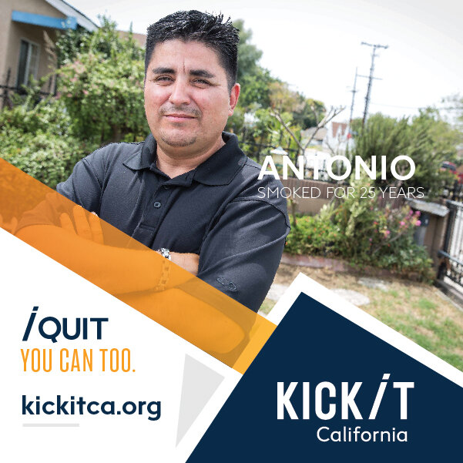
Who Do We Serve?
Adults (multiple languages, Medi-Cal, range of income, rural & urban, behavioral health, etc.)
Chew/spit tobacco users
Pregnant/nursing women
Teens
Non-tobacco using callers (proxy)
Notes:
Kick It California has helped people make positive behavior change for 30 years. We know what works and we know it can work for you, too. Our program is based in science. It’s proven effective. And best of all, it’s completely free.

Slide 7

The Importance of Proactive Referrals From Providers

Slide 8



Using Ask-Advise-Refer (AAR)
Ask (At every visit, in a caring manner, ask each patient if they smoke/vape)
Do you (or anyone you live with) smoke?
How interested are you in quitting?
Advise (without lecturing)
Quitting is one of the best things you can do for your yourself
What do you know about how smoking affects health?
I have some information, if you’d like to hear?
Refer (connect/offer options)
Refer tobacco users (or those who live with tobacco users) to KIC to get a free, one-on-one coaching, and a personal quit plan (or a plan to help someone quit) from our trained Quit Coaches
Notes:
People are more likely to get Kick It coaching when referred by their healthcare providers. This is where you come in!
We ask that you use the Ask-Advise-Refer protocol.
Ask every patient if they use tobacco or live with someone who does
Advise them to quit, even if they’ve tried before and failed. Every attempt is important
Refer tobacco users (or those who live with a tobacco user) to Kick It California to get a free, personal quit plan (or plan to help someone quit) from our trained quit coaches

Slide 9
Referring to KIC
Proactive Referrals
Electronic referrals (through health record) or web-based referral
Means KIC calls the patient – patient doesn’t initiate the call
Workflow for Proactive Referrals:
Clinic/Hospital:
Screens patient for tobacco use
Sends referral to KIC
KIC:
Receives patient information
Attempts patient to try and enroll in services
Notes:
Referring to KIC is quick and easy. Proactive referrals mean that KIC receives patient information and will reach out to the patient. The patient doesn’t initiate the call.
The referral can be an electronic referral (through the electronic health record) or a web-based referral.

Slide 10





Reasons for e-Referral
Associated with a significantly higher participation rate than simple advice to quit (2-3% vs 40%)
Promotes the use of electronic health records (EHR) to improve healthcare delivery; can help organizations meet various metrics (MU, PRIME, etc.)
Clinical teams can make a big impact on the lives of their patients and reduce health care costs by referring them evidence-based tobacco treatment (i.e. KIC)

Slide 11
Benefits of KIC e-Referral
Documentation
Smoking Status
Reduce provider burden
Off-load work to “experts”
Patients will get the message that staff want to help them quit.
Reach
High risk populations with high tobacco rates
Tobacco Interventions

Slide 12

How Providers Can Make a Difference

Slide 13
Promotional ideas
Produce signage with the QR code and place it around the clinic so patients that are waiting can scan the code and enroll in the program
Create support materials
To encourage the patients to enroll via QR code/short link
To let them know what to expect after being referred
Text out bitly link
After Visit Summary
List phone number, KIC, etc.
Send MyChart (or message through EHR)
Helps prime the patient so when KIC calls doesn’t feel like a cold call
Use QR code in traditional mail to follow up about a visit, reminders, surveys etc.

Slide 14

Thank you!
Questions? Please email
ckirby@health.ucsd.edu

